Slide 1
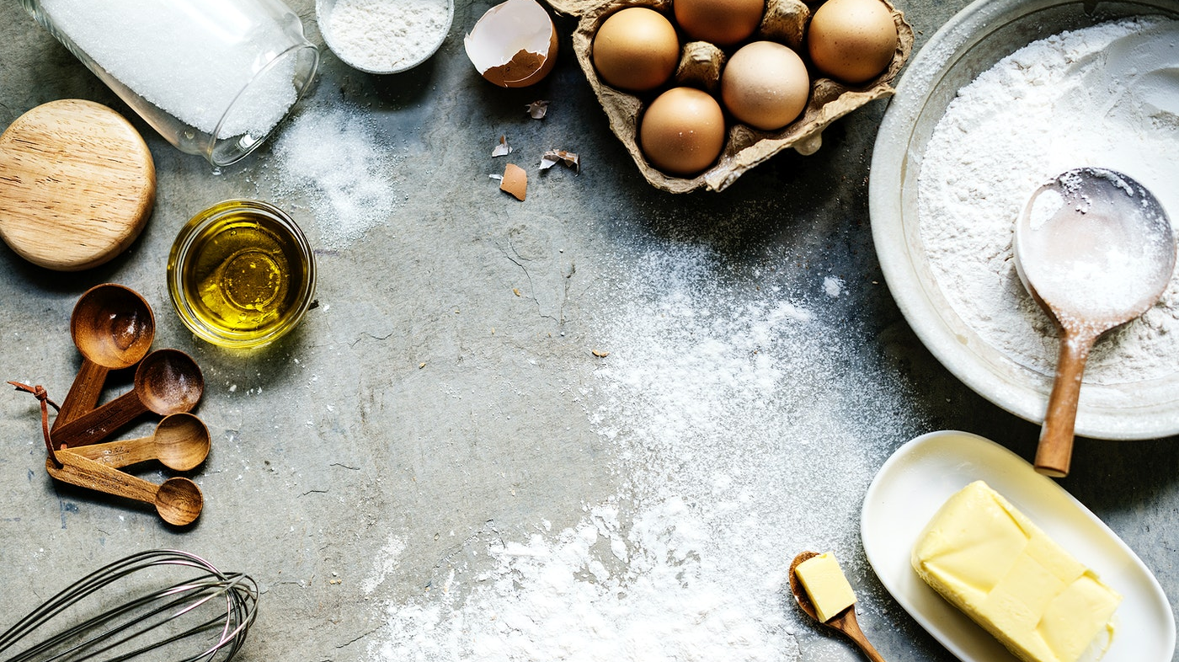
Baking Cookies with Marina

Slide 2
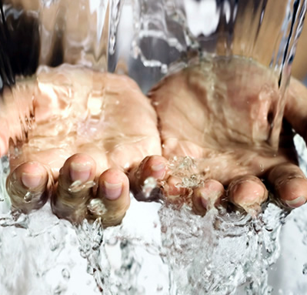
Remember to wash your hands!
Pre-heat oven to 200c/180c Fan/Gas mark 4

Slide 3
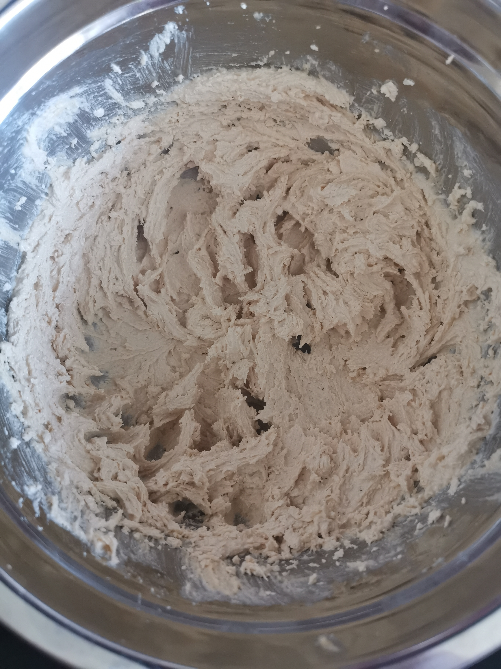
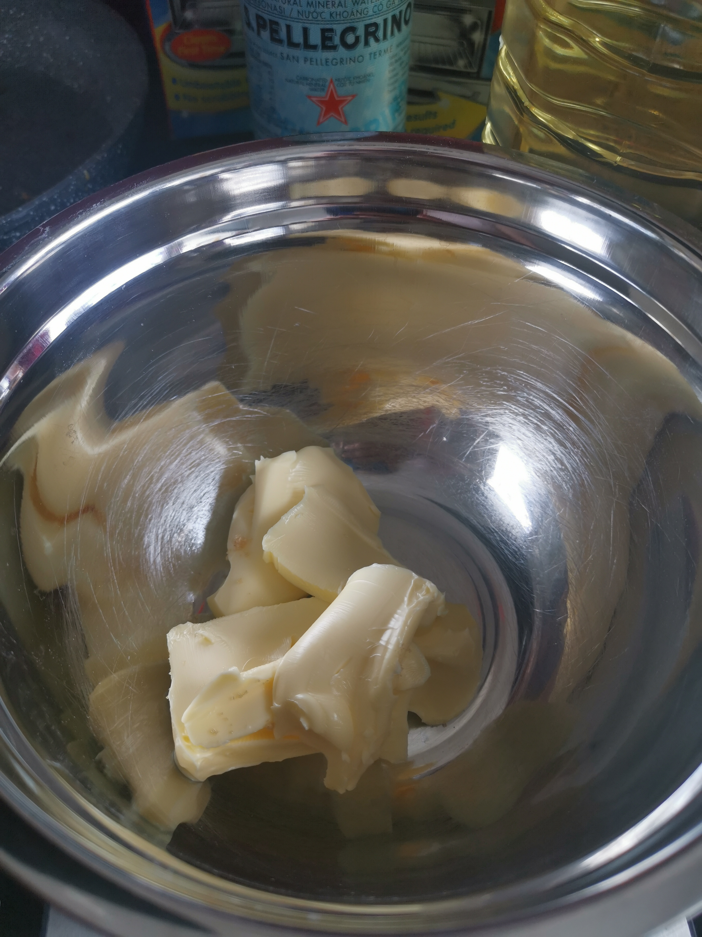
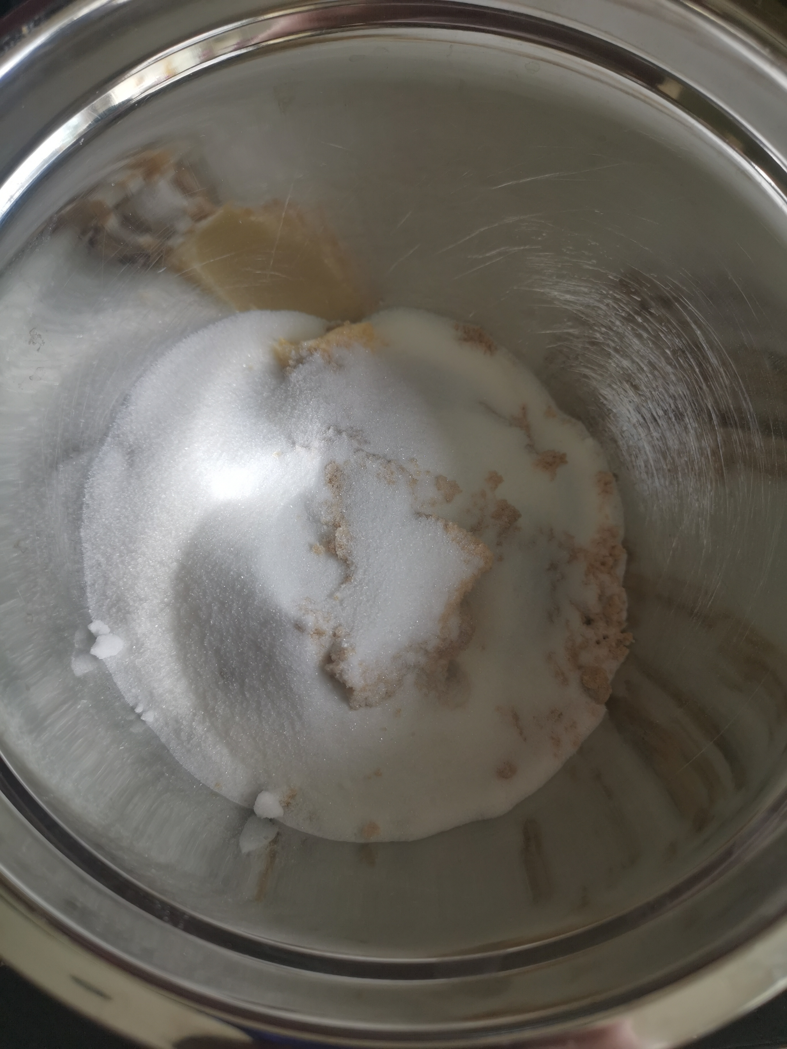
Put your butter and sugar into a mixing bowl
Whisk together until light in colour and slightly fluffy

Slide 4
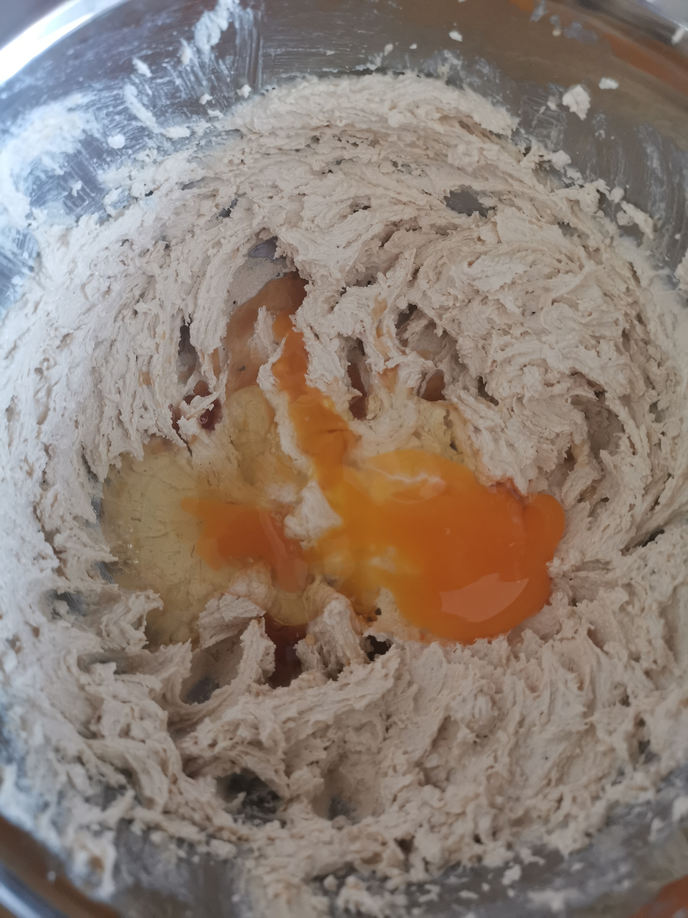
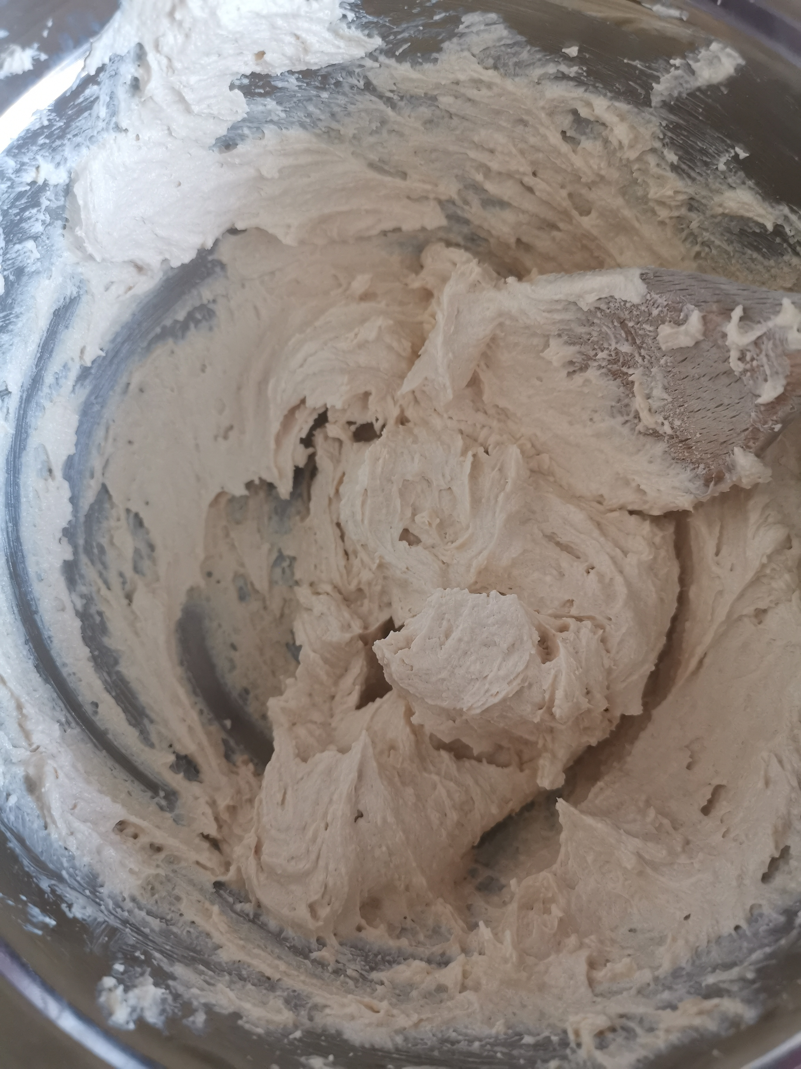
Add your egg and vanilla essence
Beat together with a wooden spoon

Slide 5
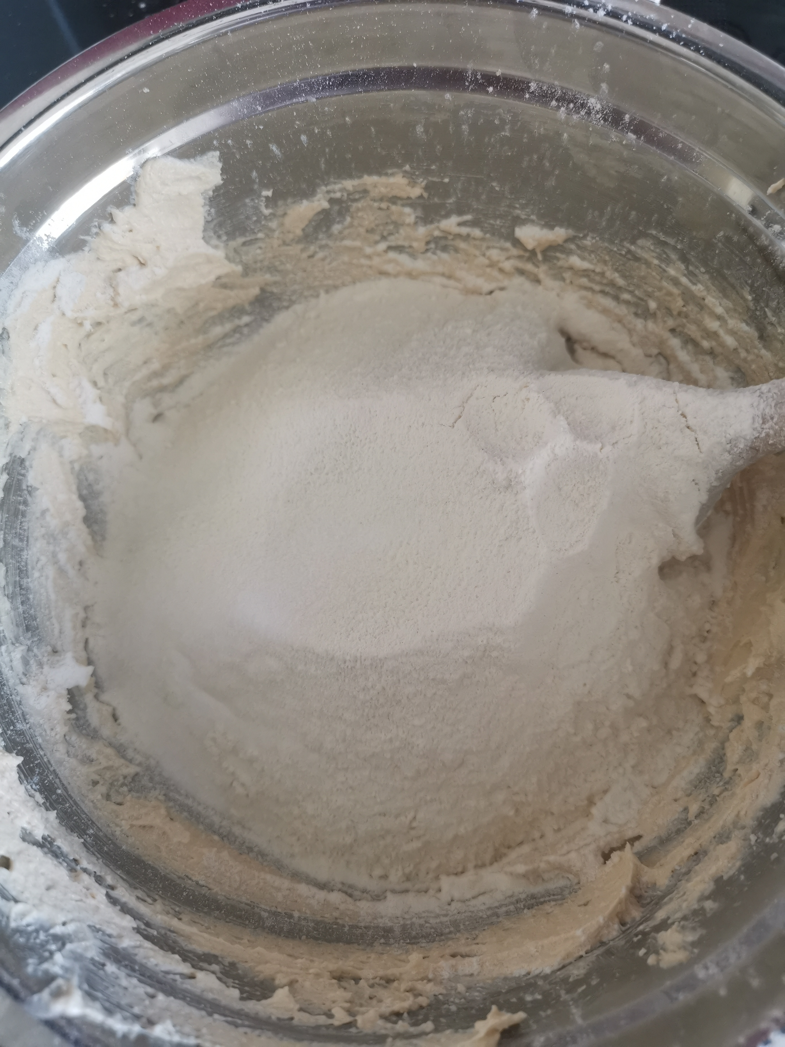
Sieve in your flour and salt and beat together with a spoon

Slide 6
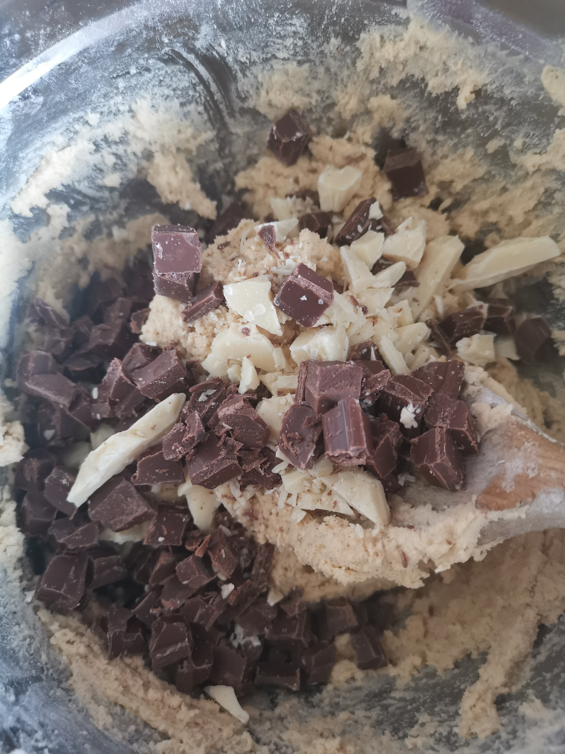
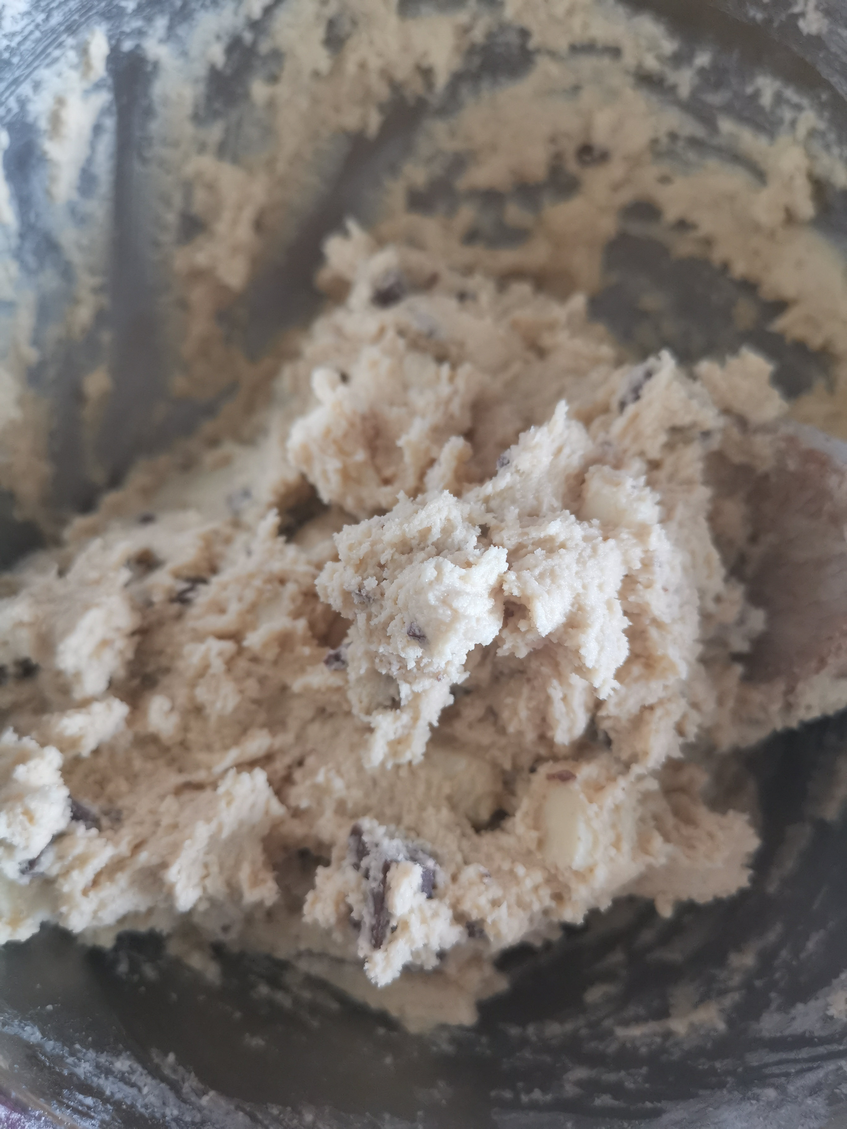
Add your chosen ingredients
Mix all, making sure your ingredients are spread out evenly throughout the dough

Slide 7
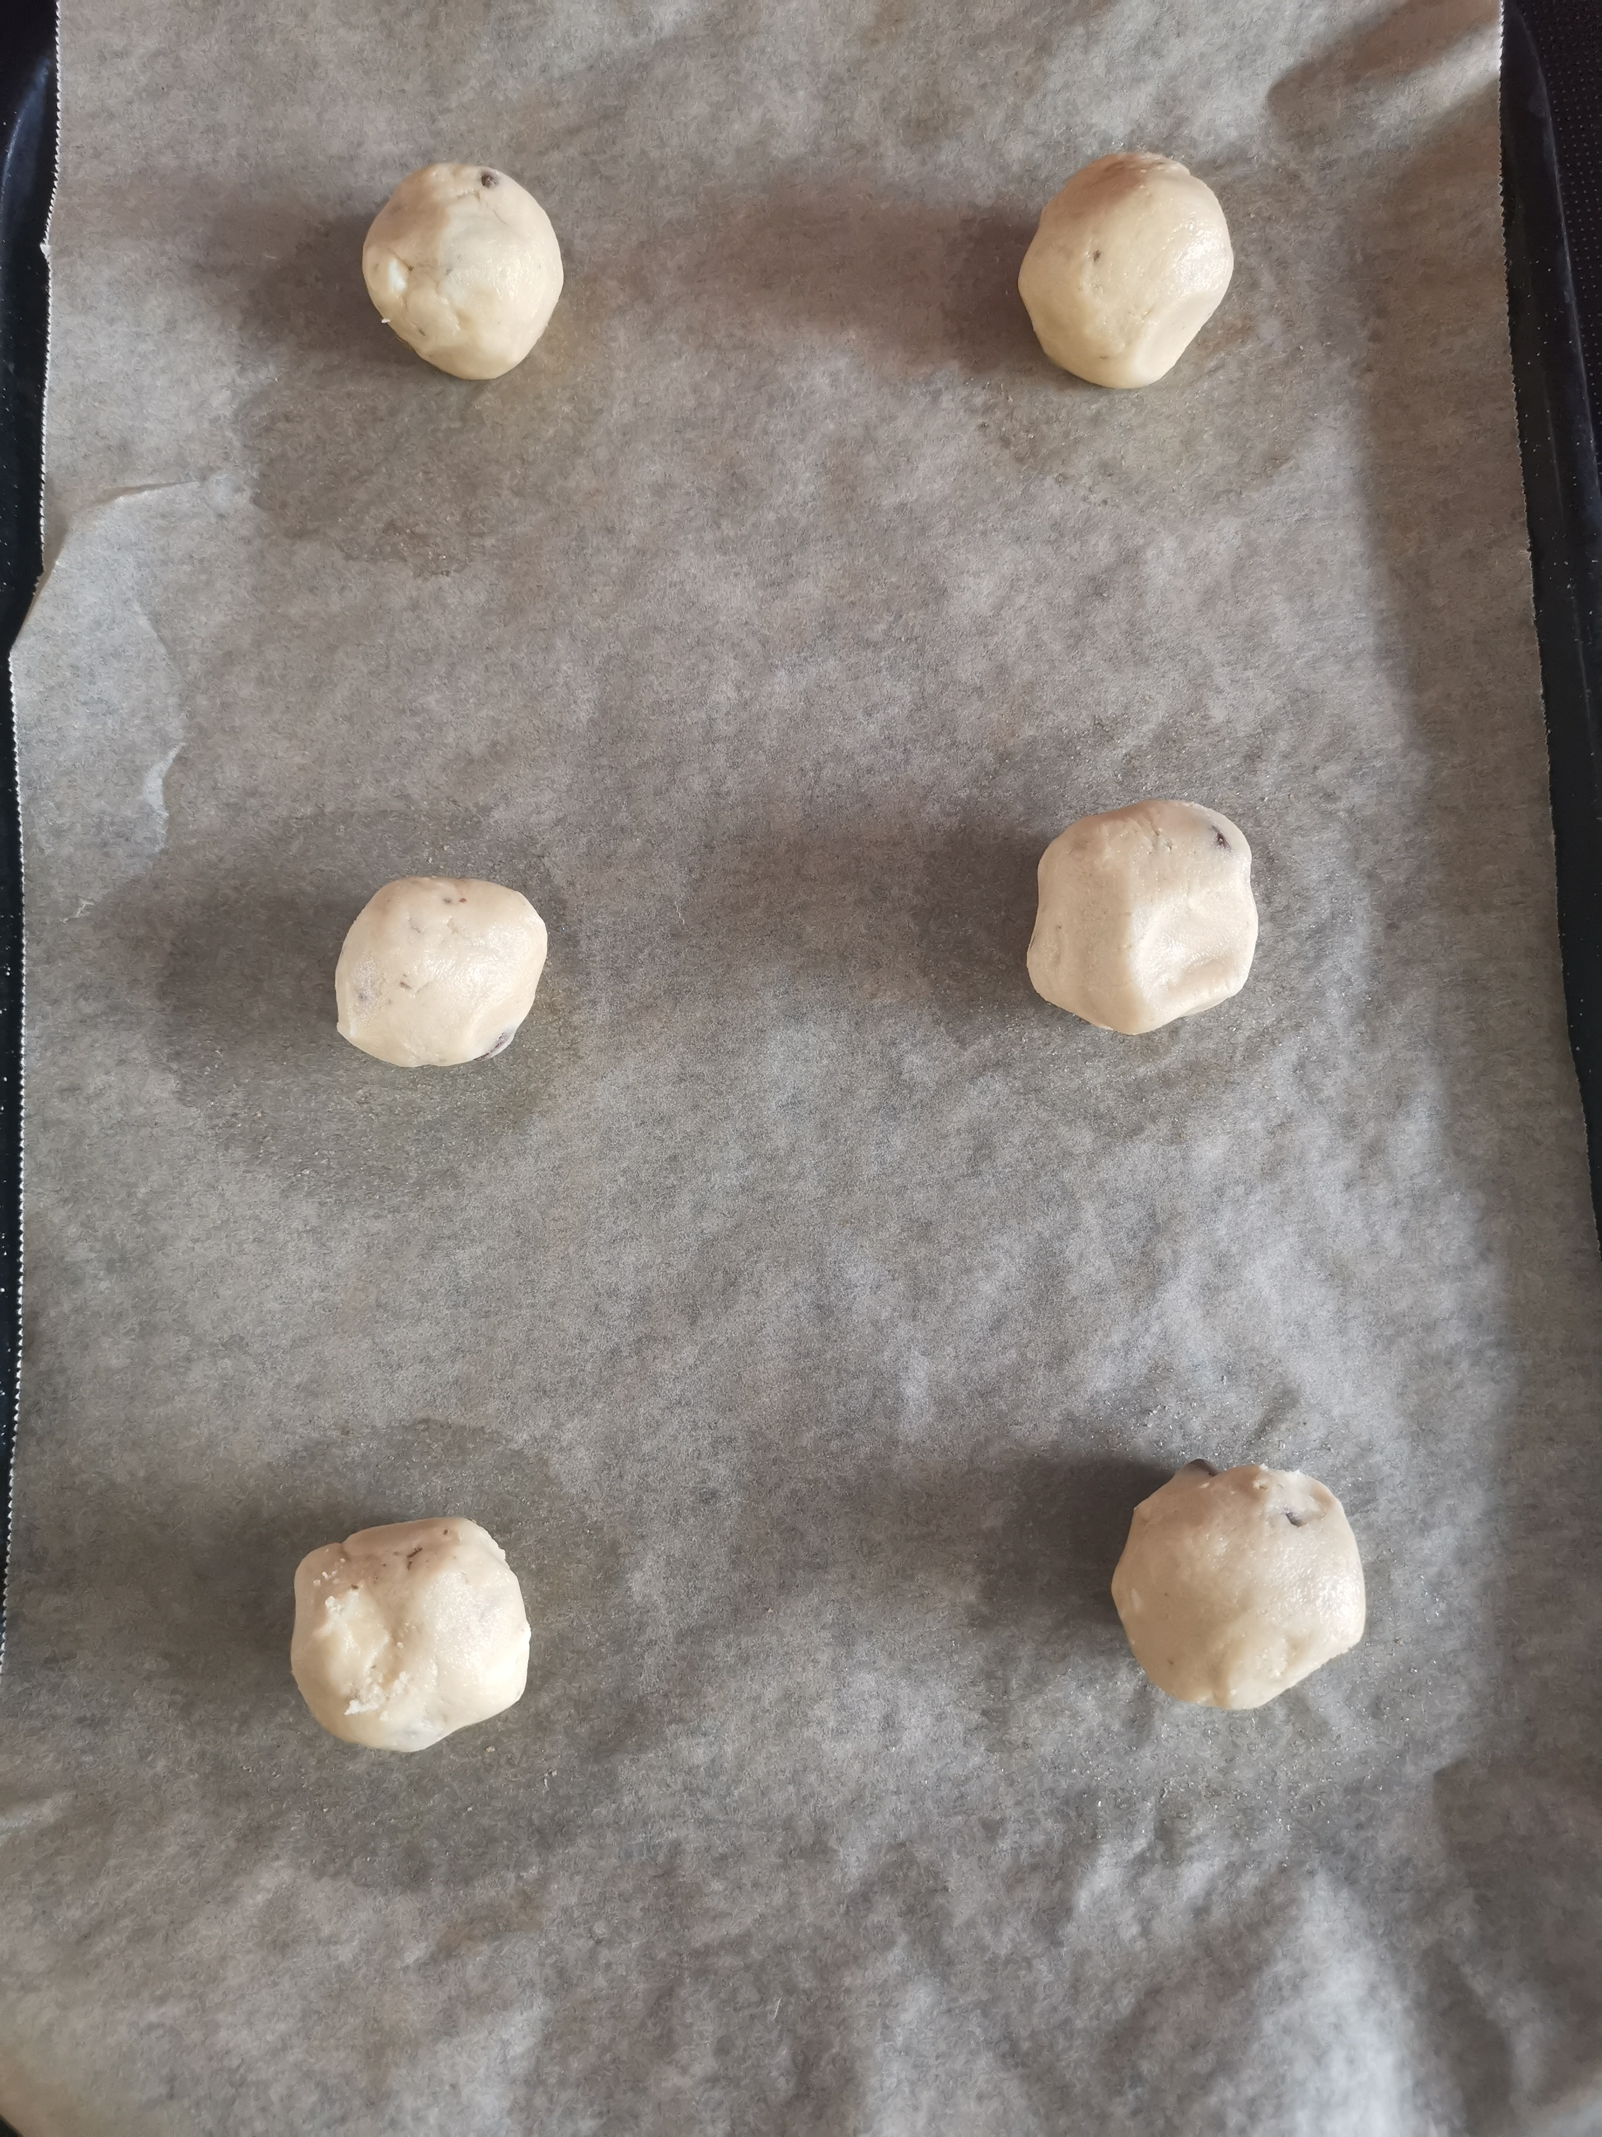
Roll your dough into balls approx. bouncy ball size and place on lined baking tray.
Make sure you leave enough space between them as they spread
Bake until slightly golden

Slide 8
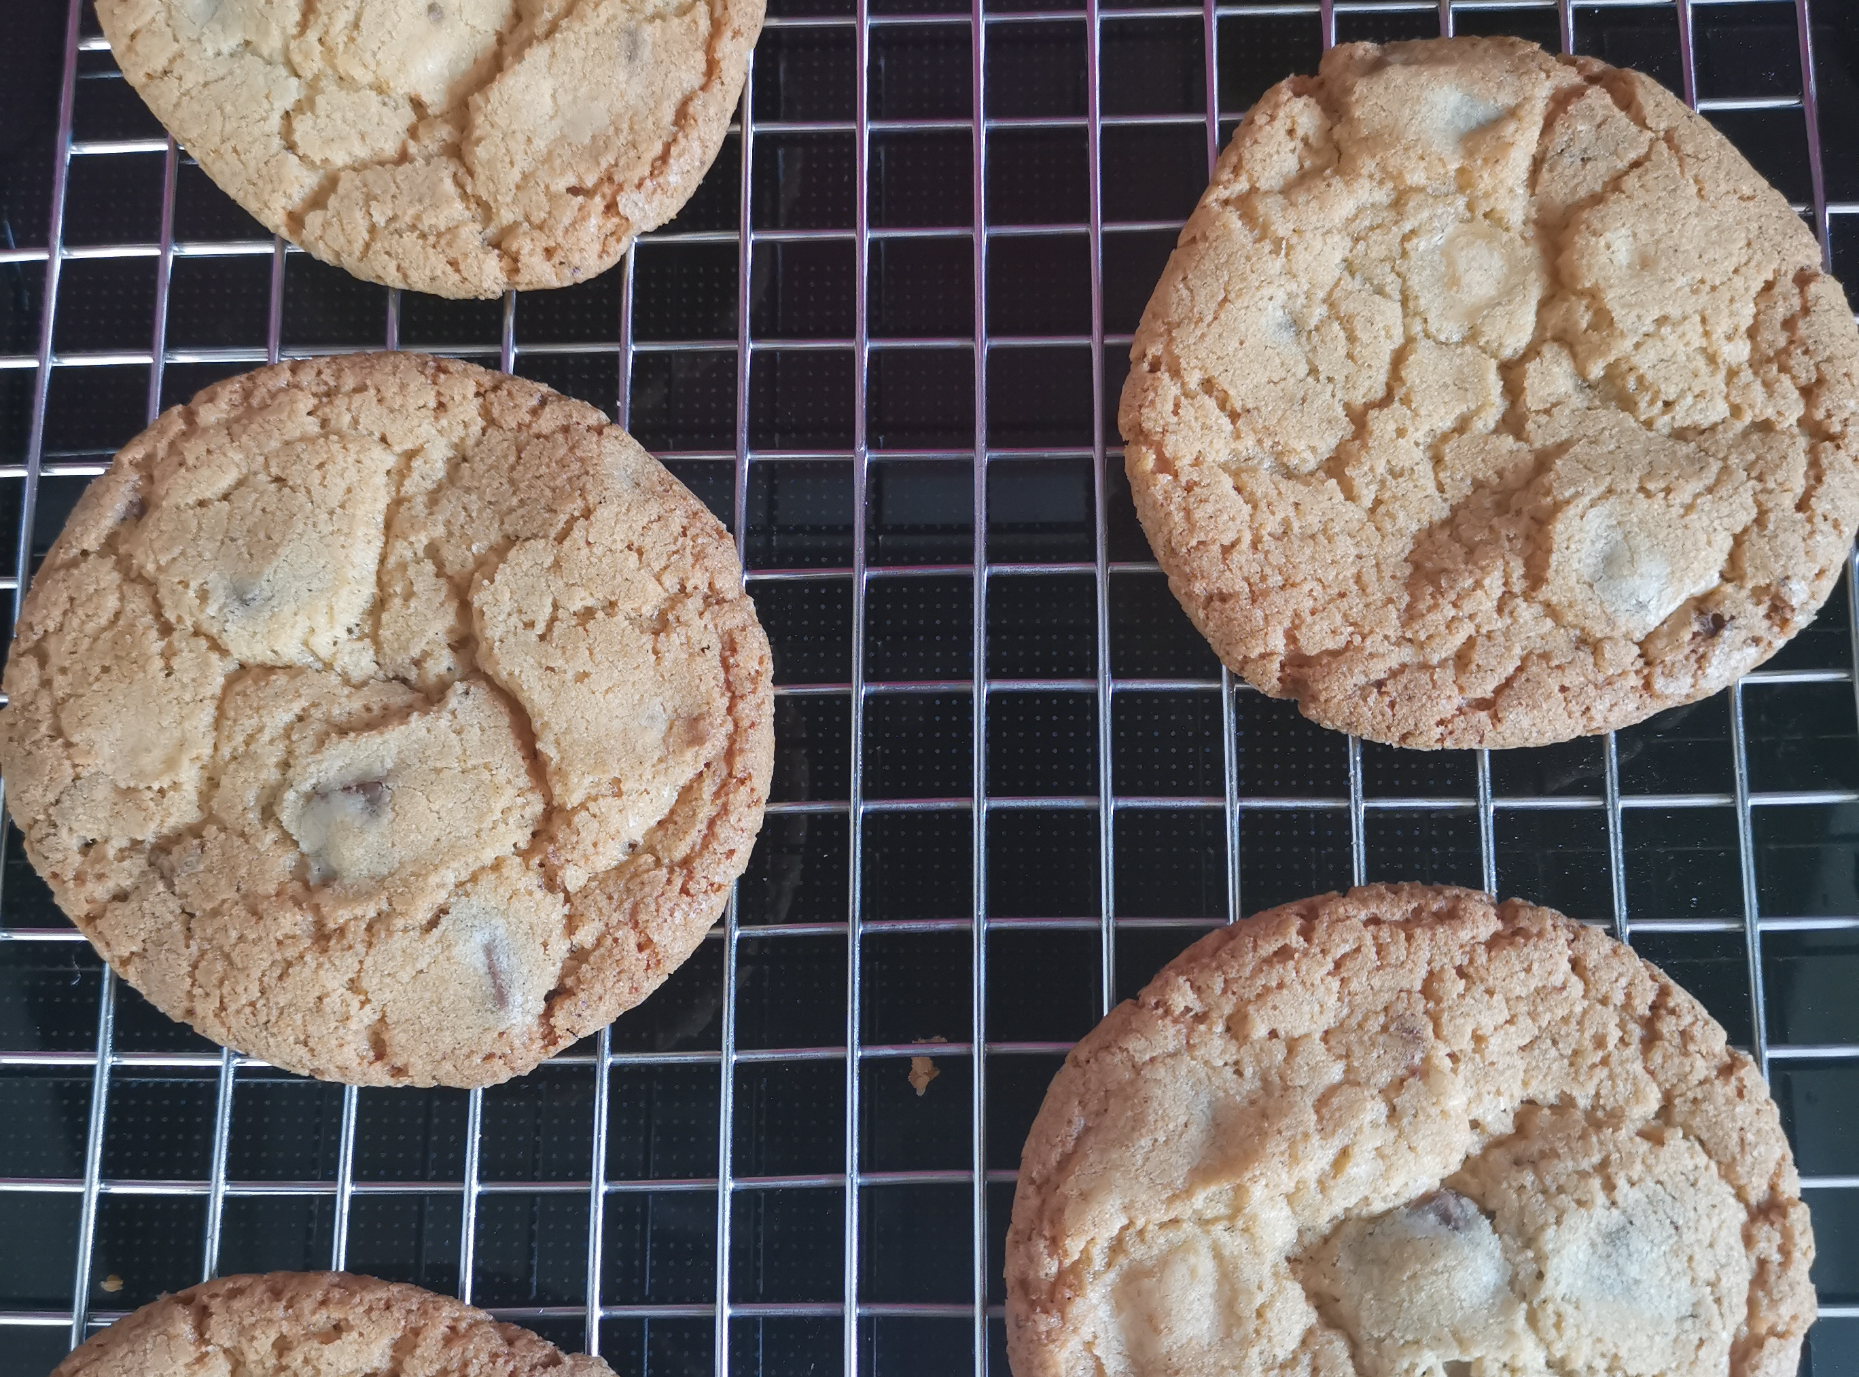
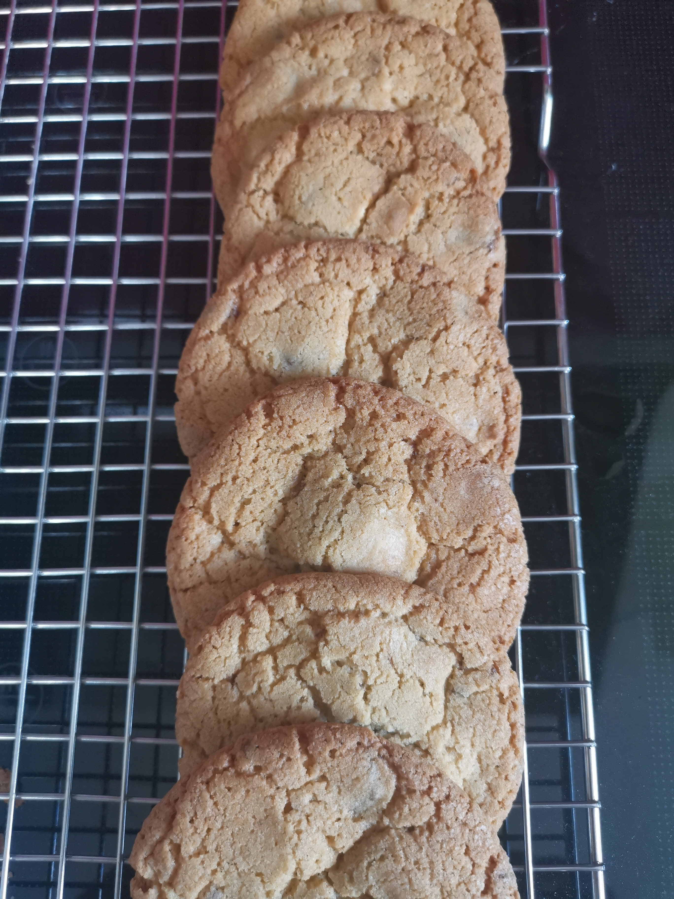
Wait for them to cool down slightly then enjoy ☺

Slide 9
Enjoy the half term!
See you again on Monday 1st June ☺

