Slide 1
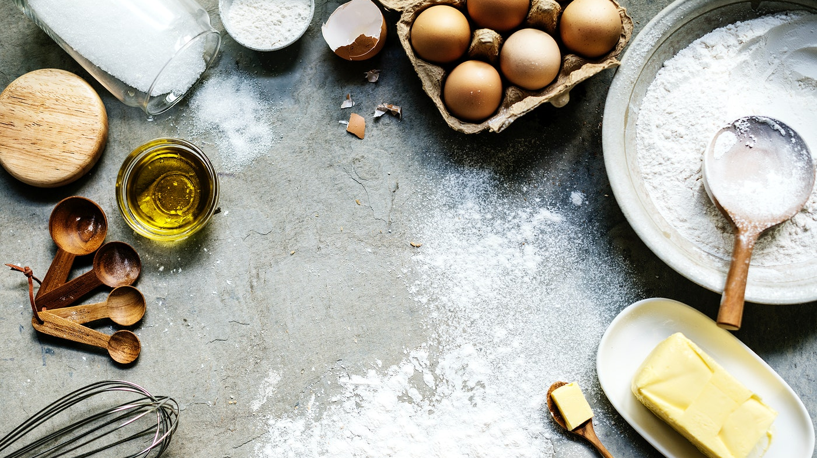
Baking Scones

Slide 2
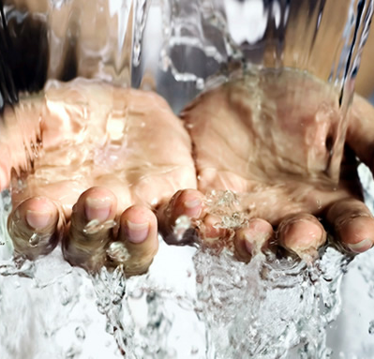
Remember to wash your hands!
Pre-heat oven to with baking tray inside 200c/180c Fan/Gas mark 6

Slide 3
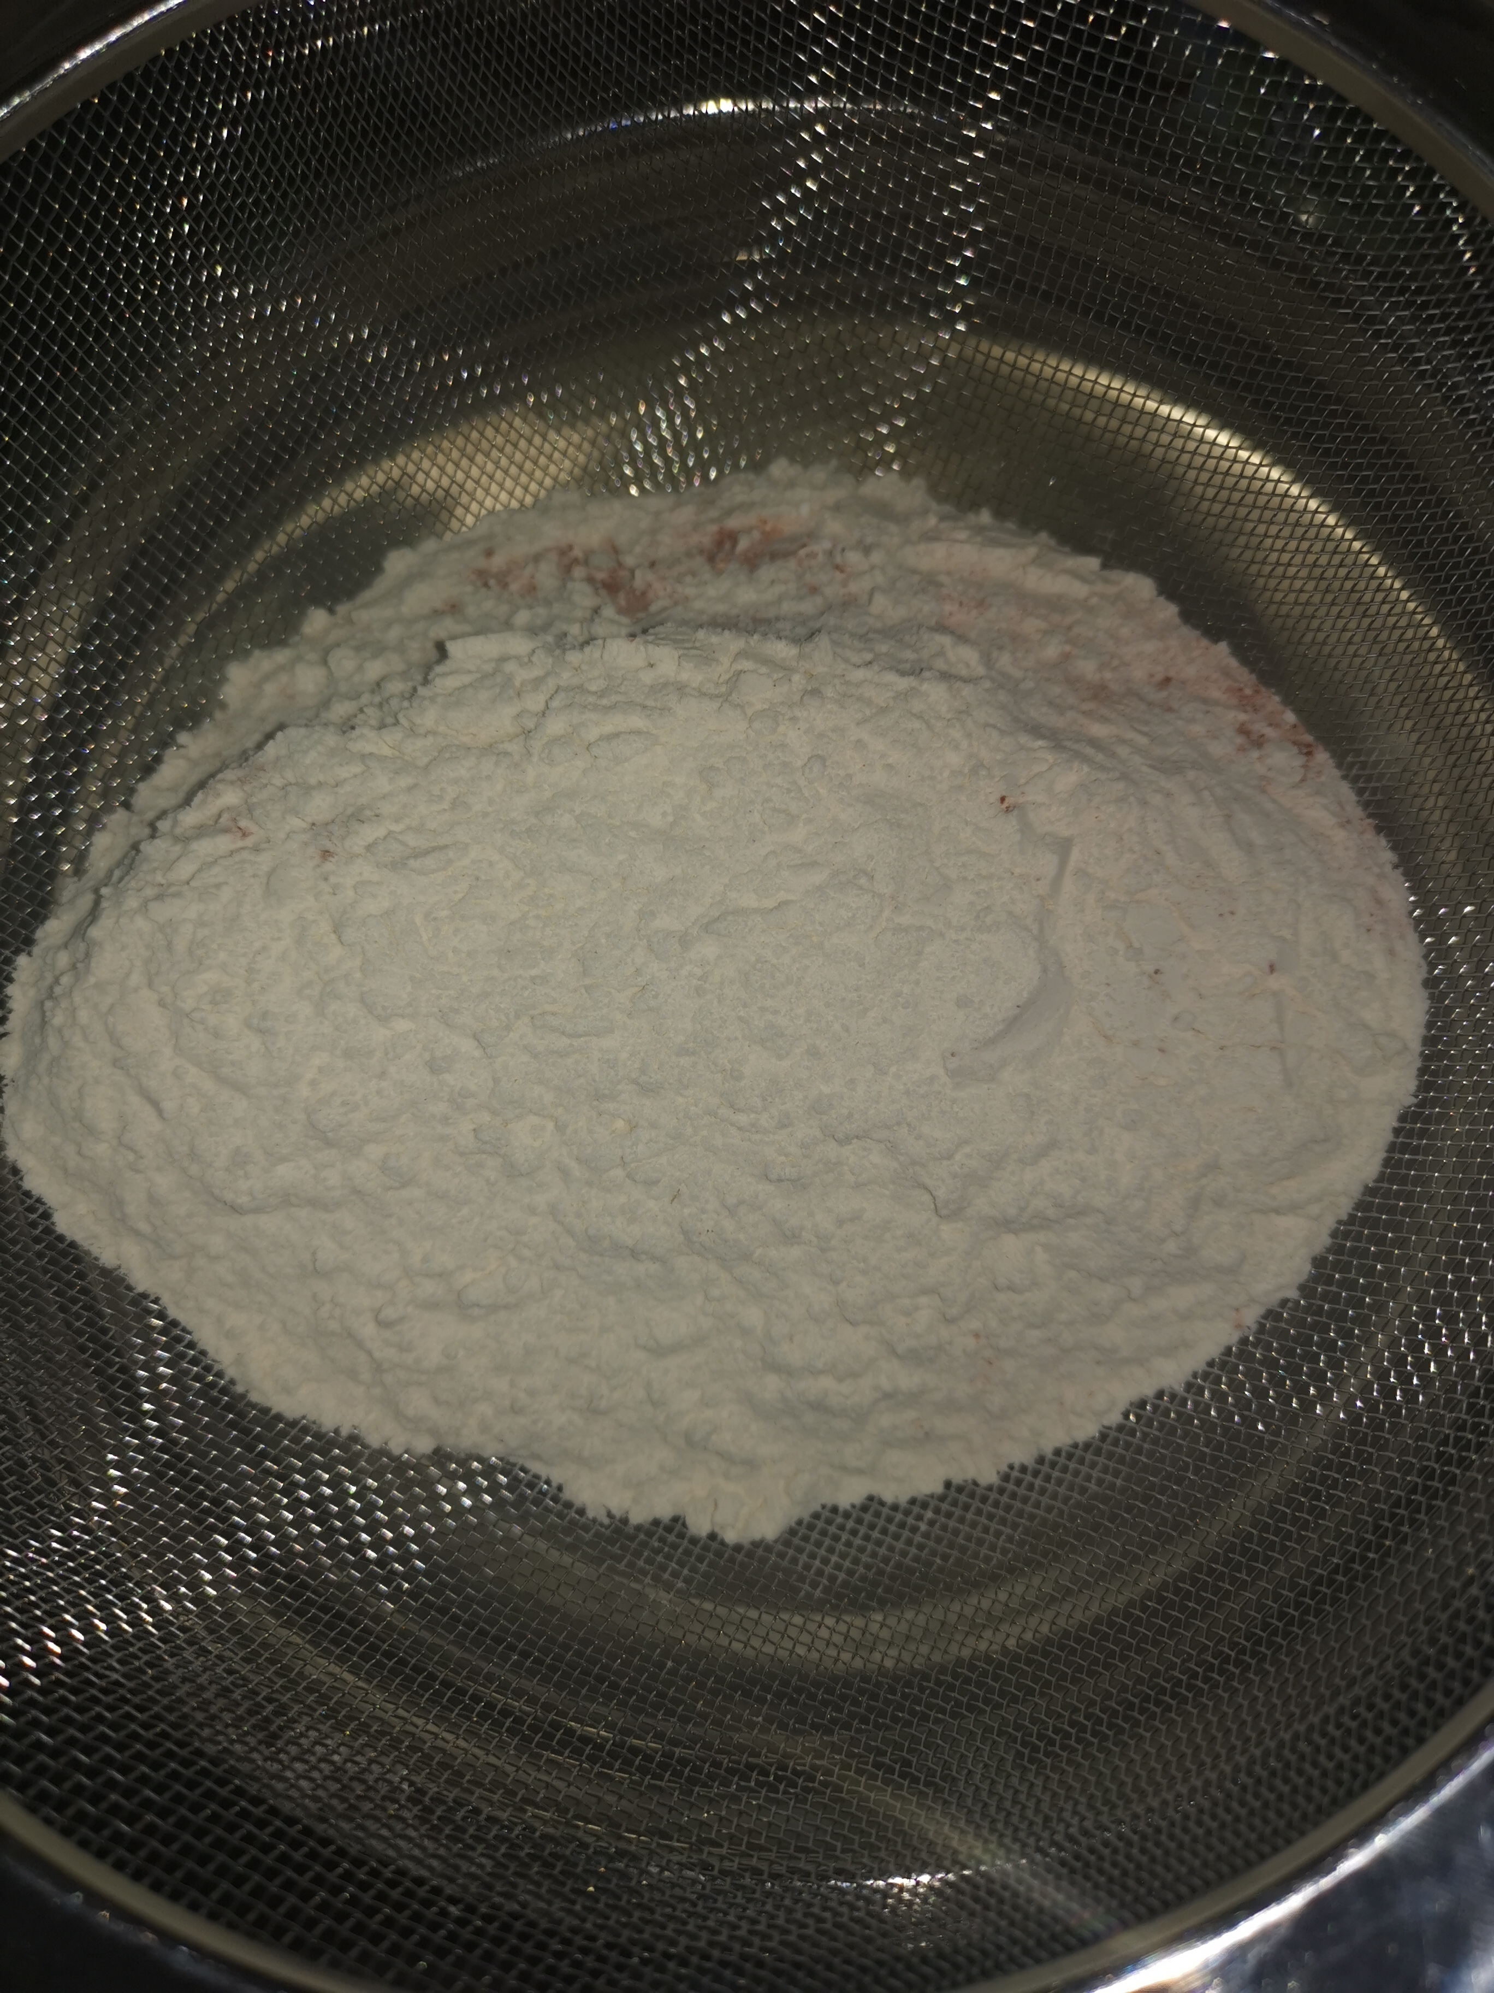
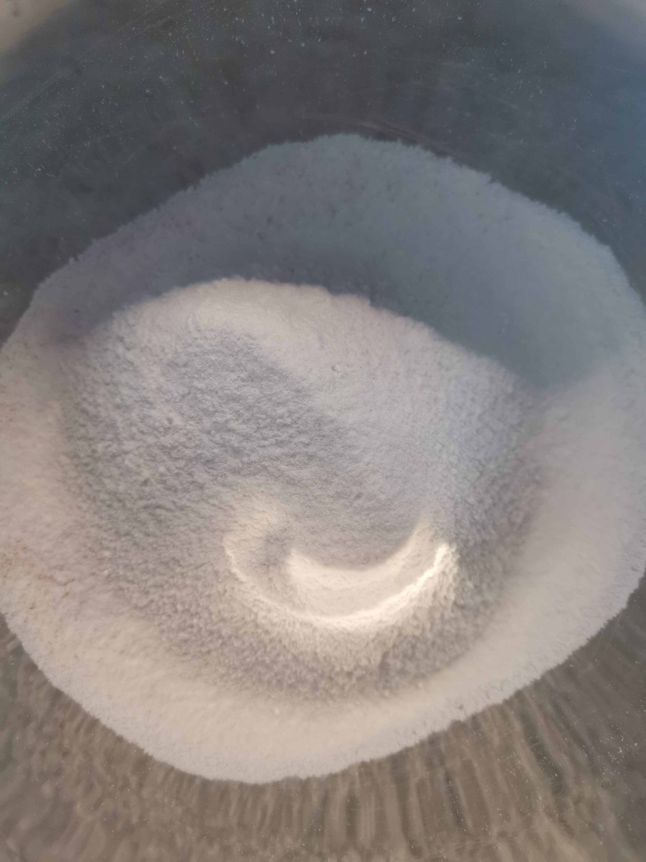
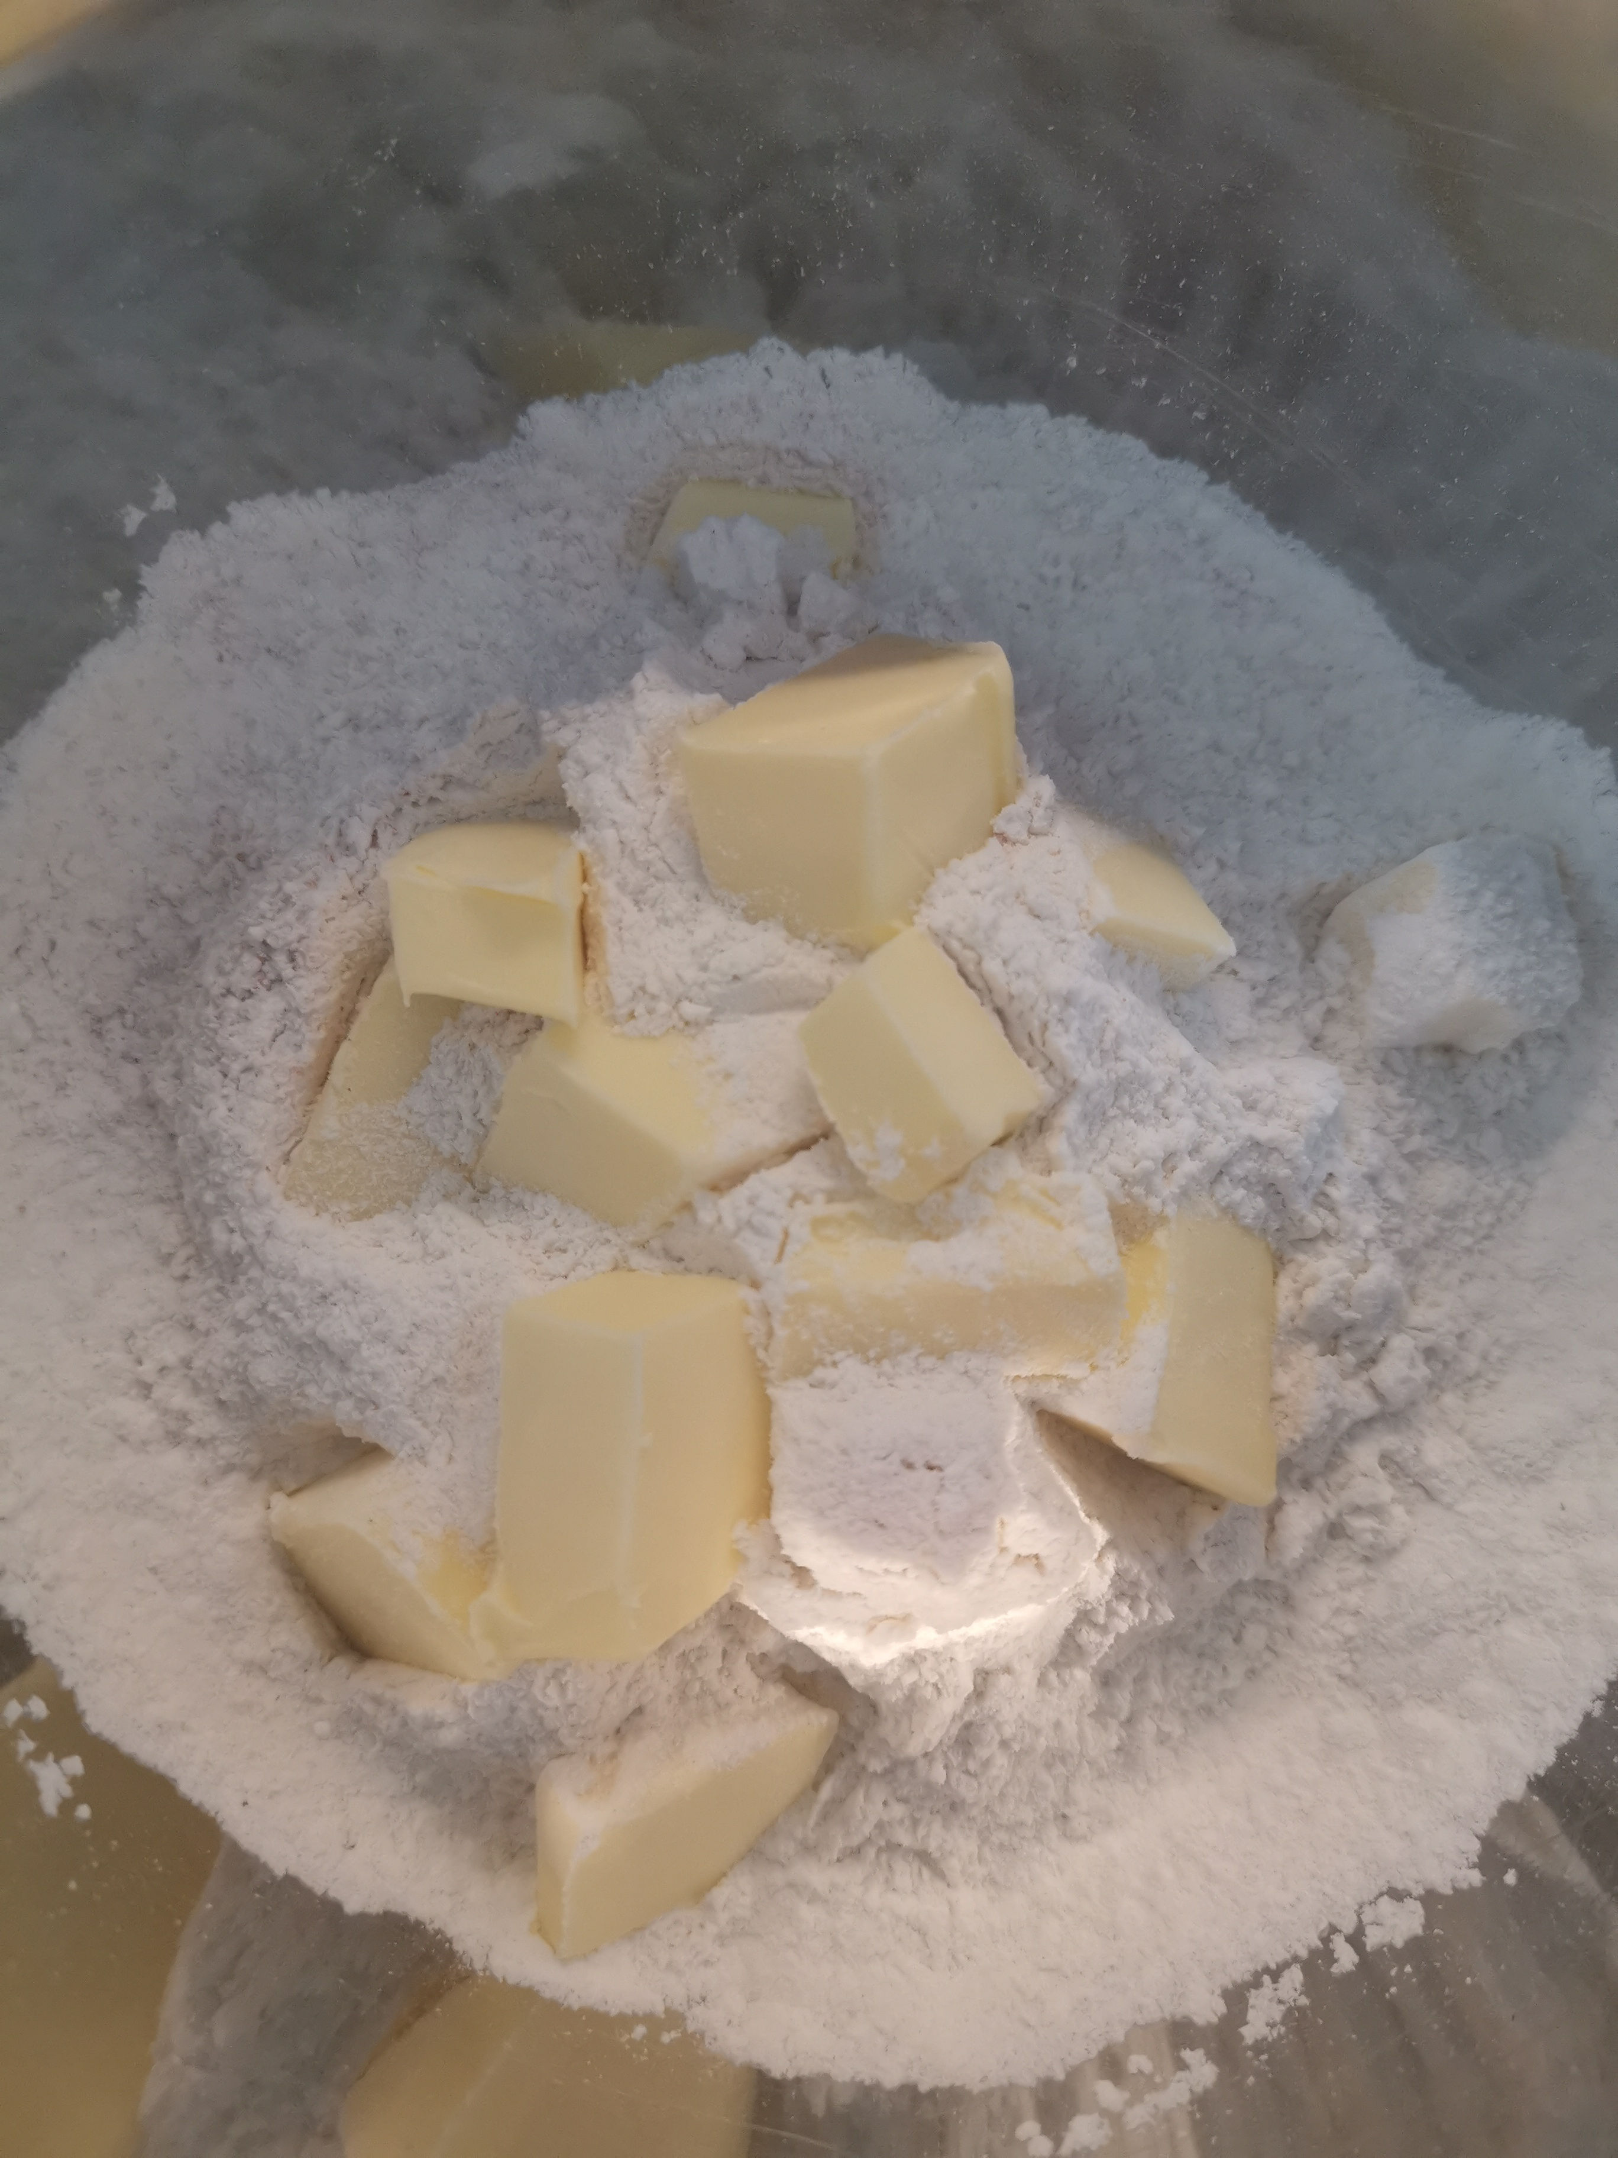
Sift together your flour, salt, herbs and baking powder into a big mixing bowl.
Chop your cold butter into cubes and add to your dry mixture.

Slide 4
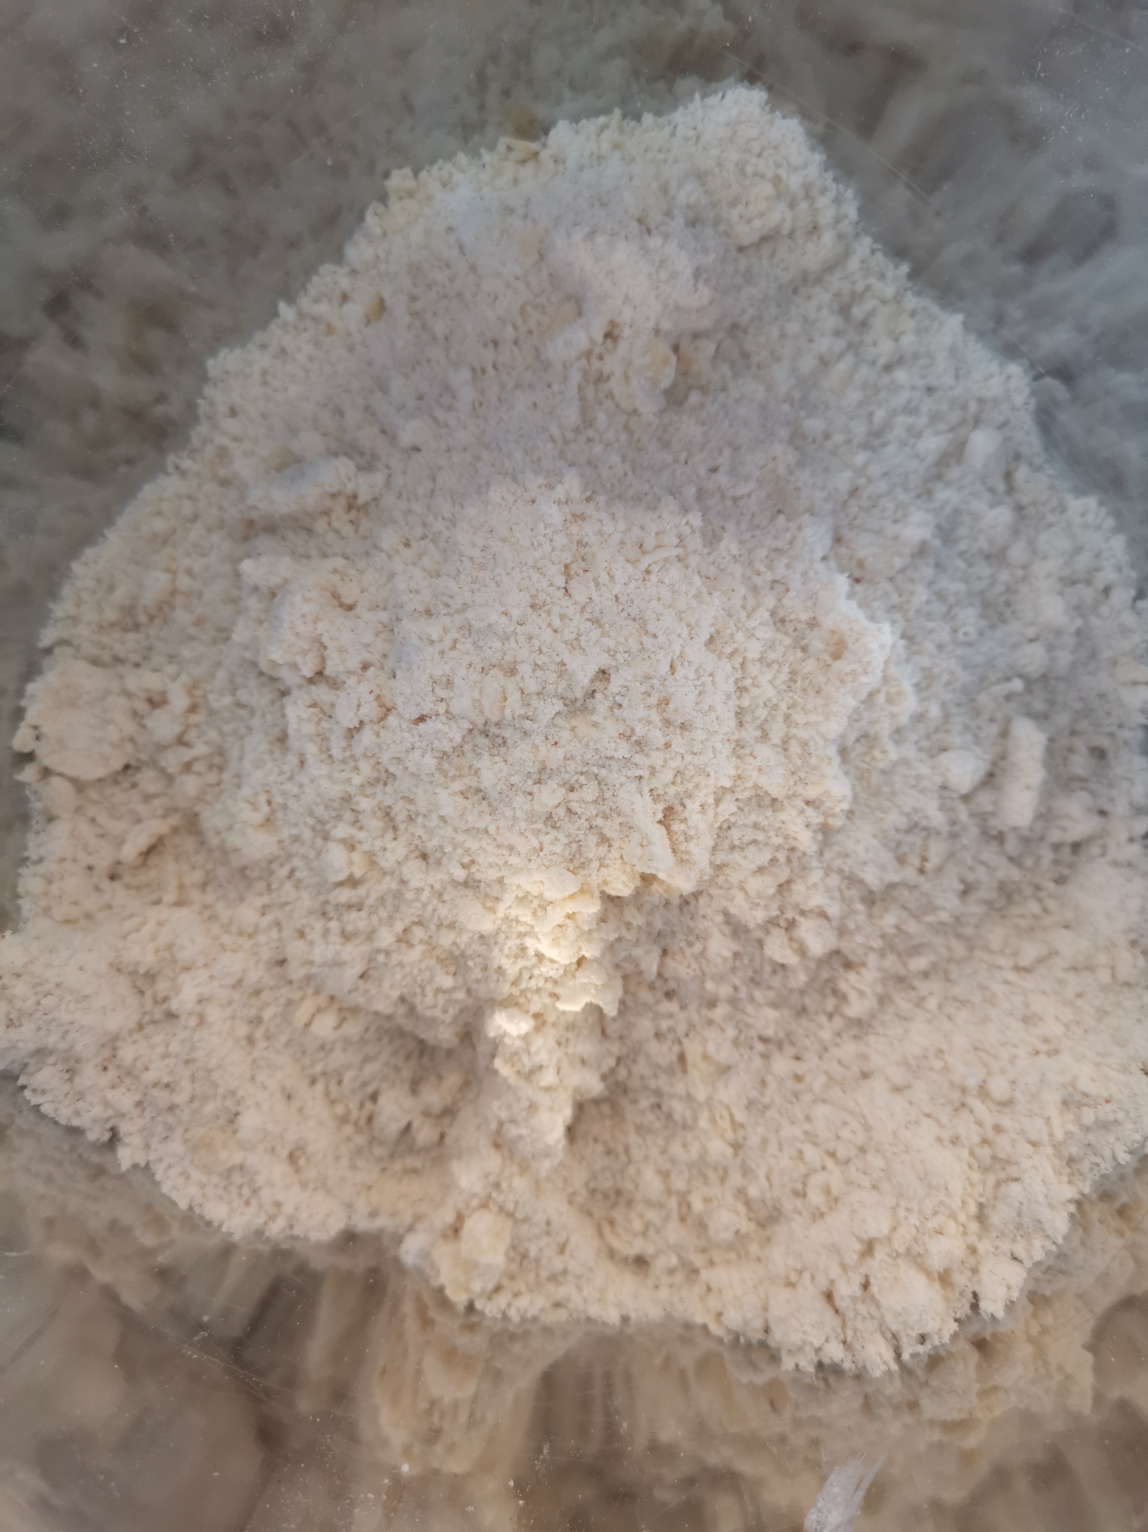
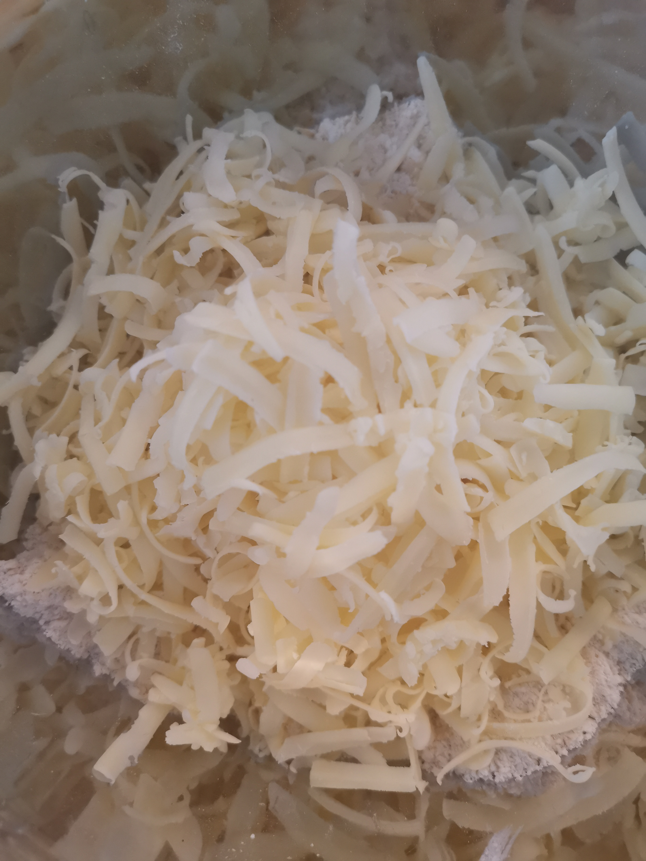
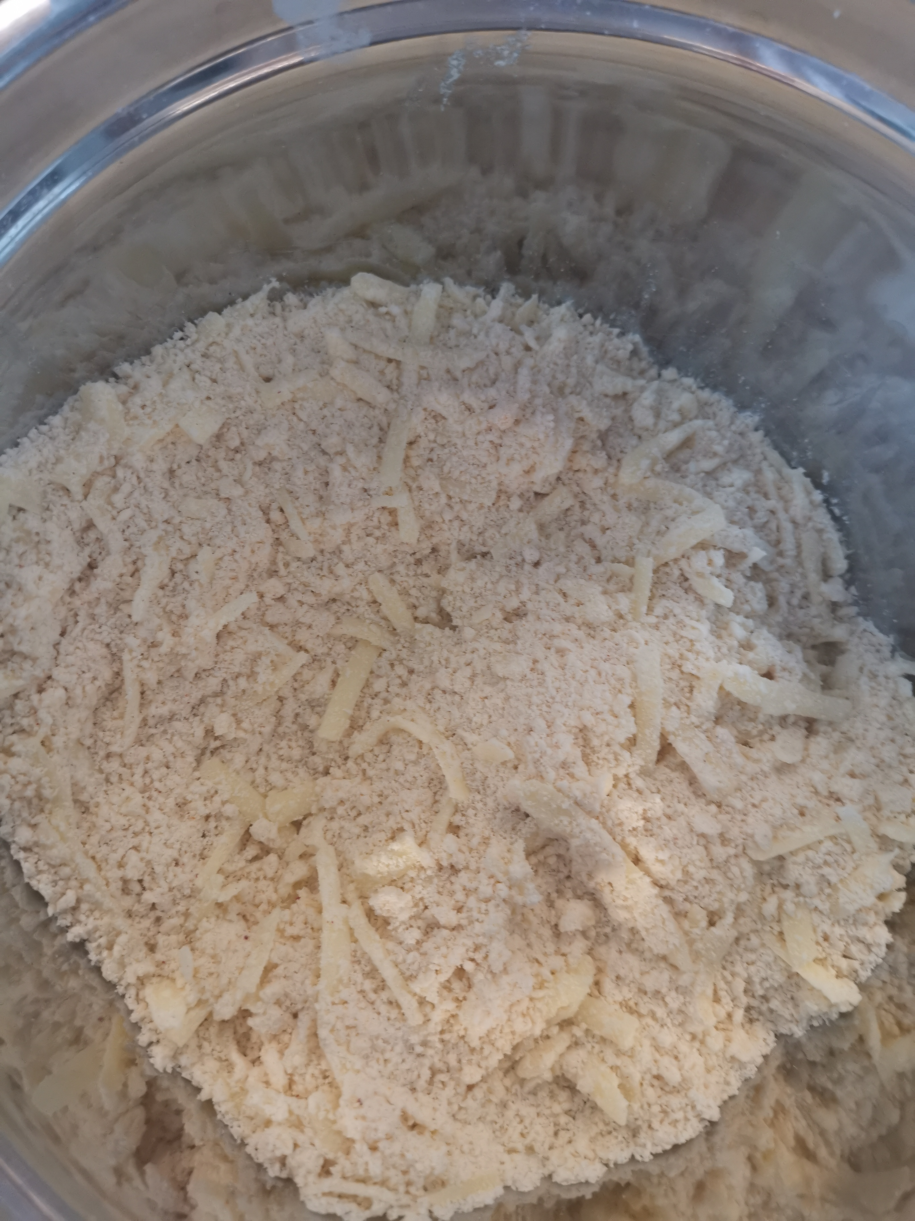
Using your fingertips, make a crumble or bread-crumb-like consistency.
Sprinkle on approx. 100g of grated cheese.
Squash together all of the ingredients making sure the cheese is spread out evenly through your mixture.

Slide 5
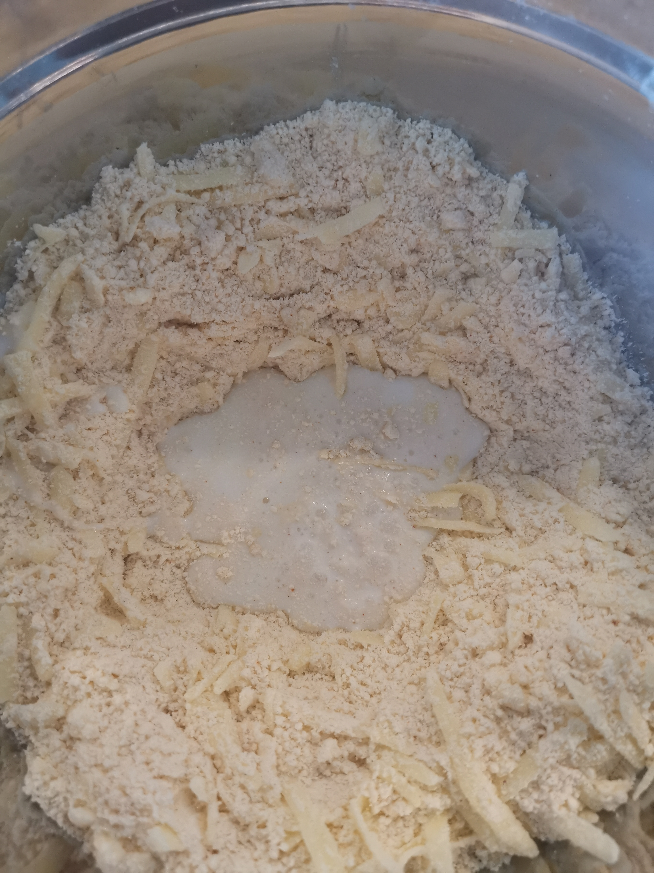
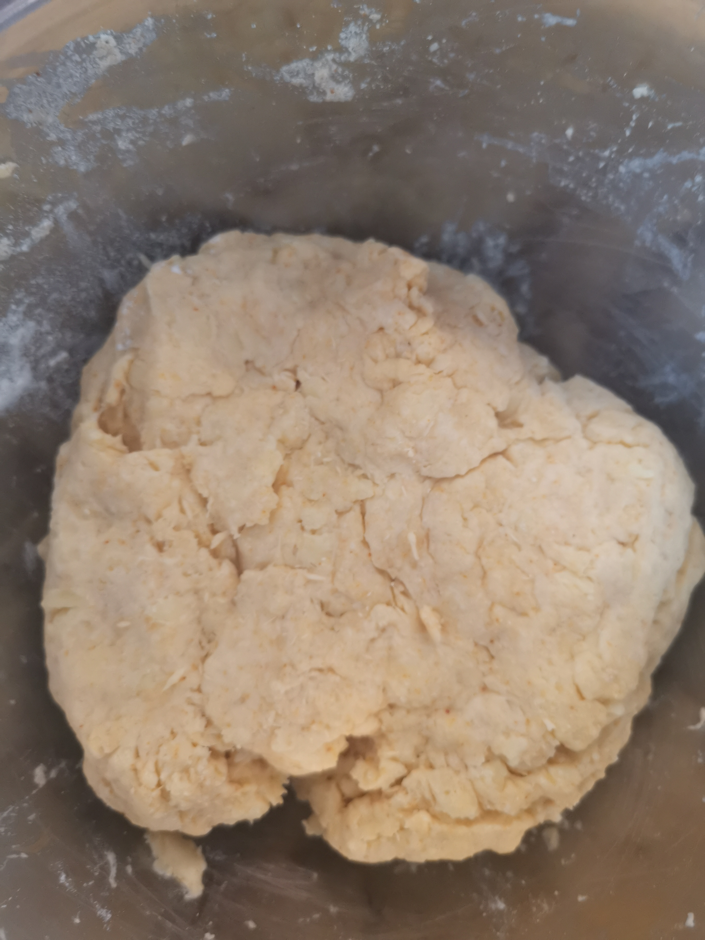
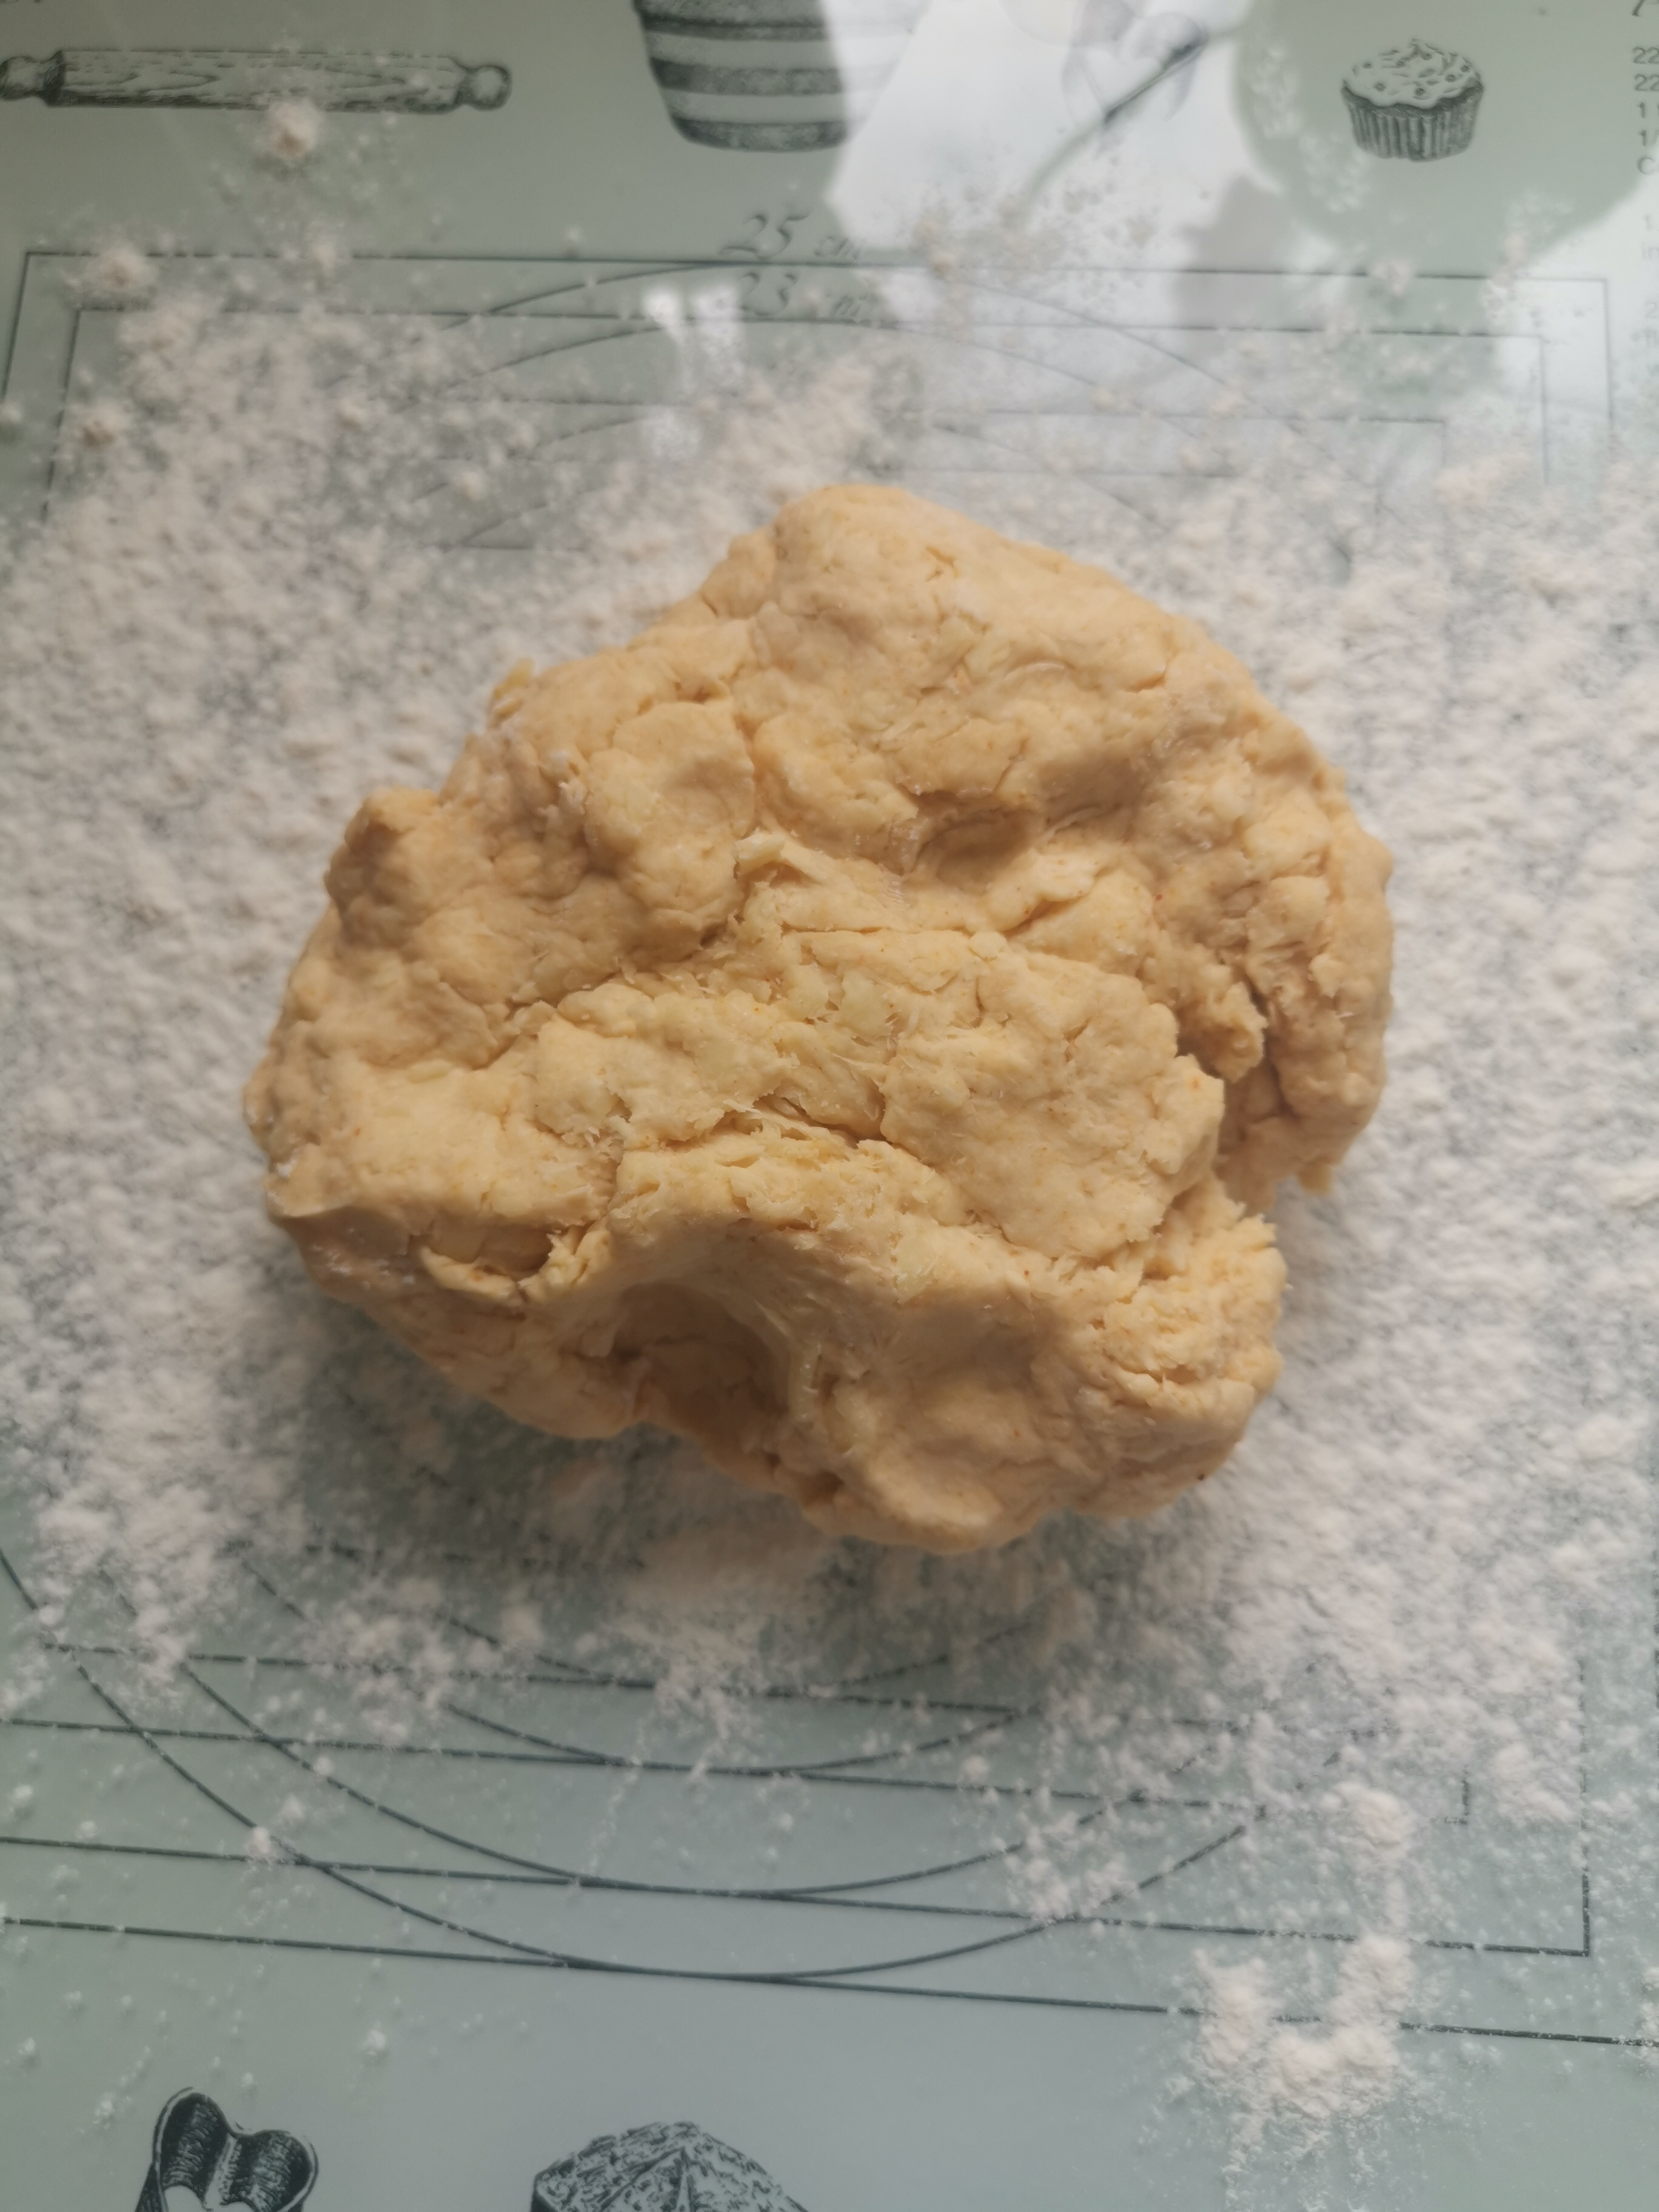
Make a well in the middle of your dry dough and add most of the milk but not all of it.
If needed, add more milk to create a slightly wet dough ball.
Sprinkle your work surface and roll dough to about 2cm thick.

Slide 6
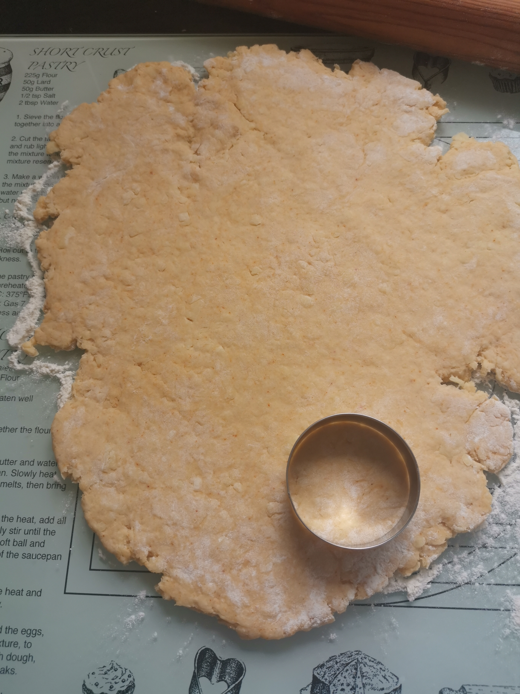
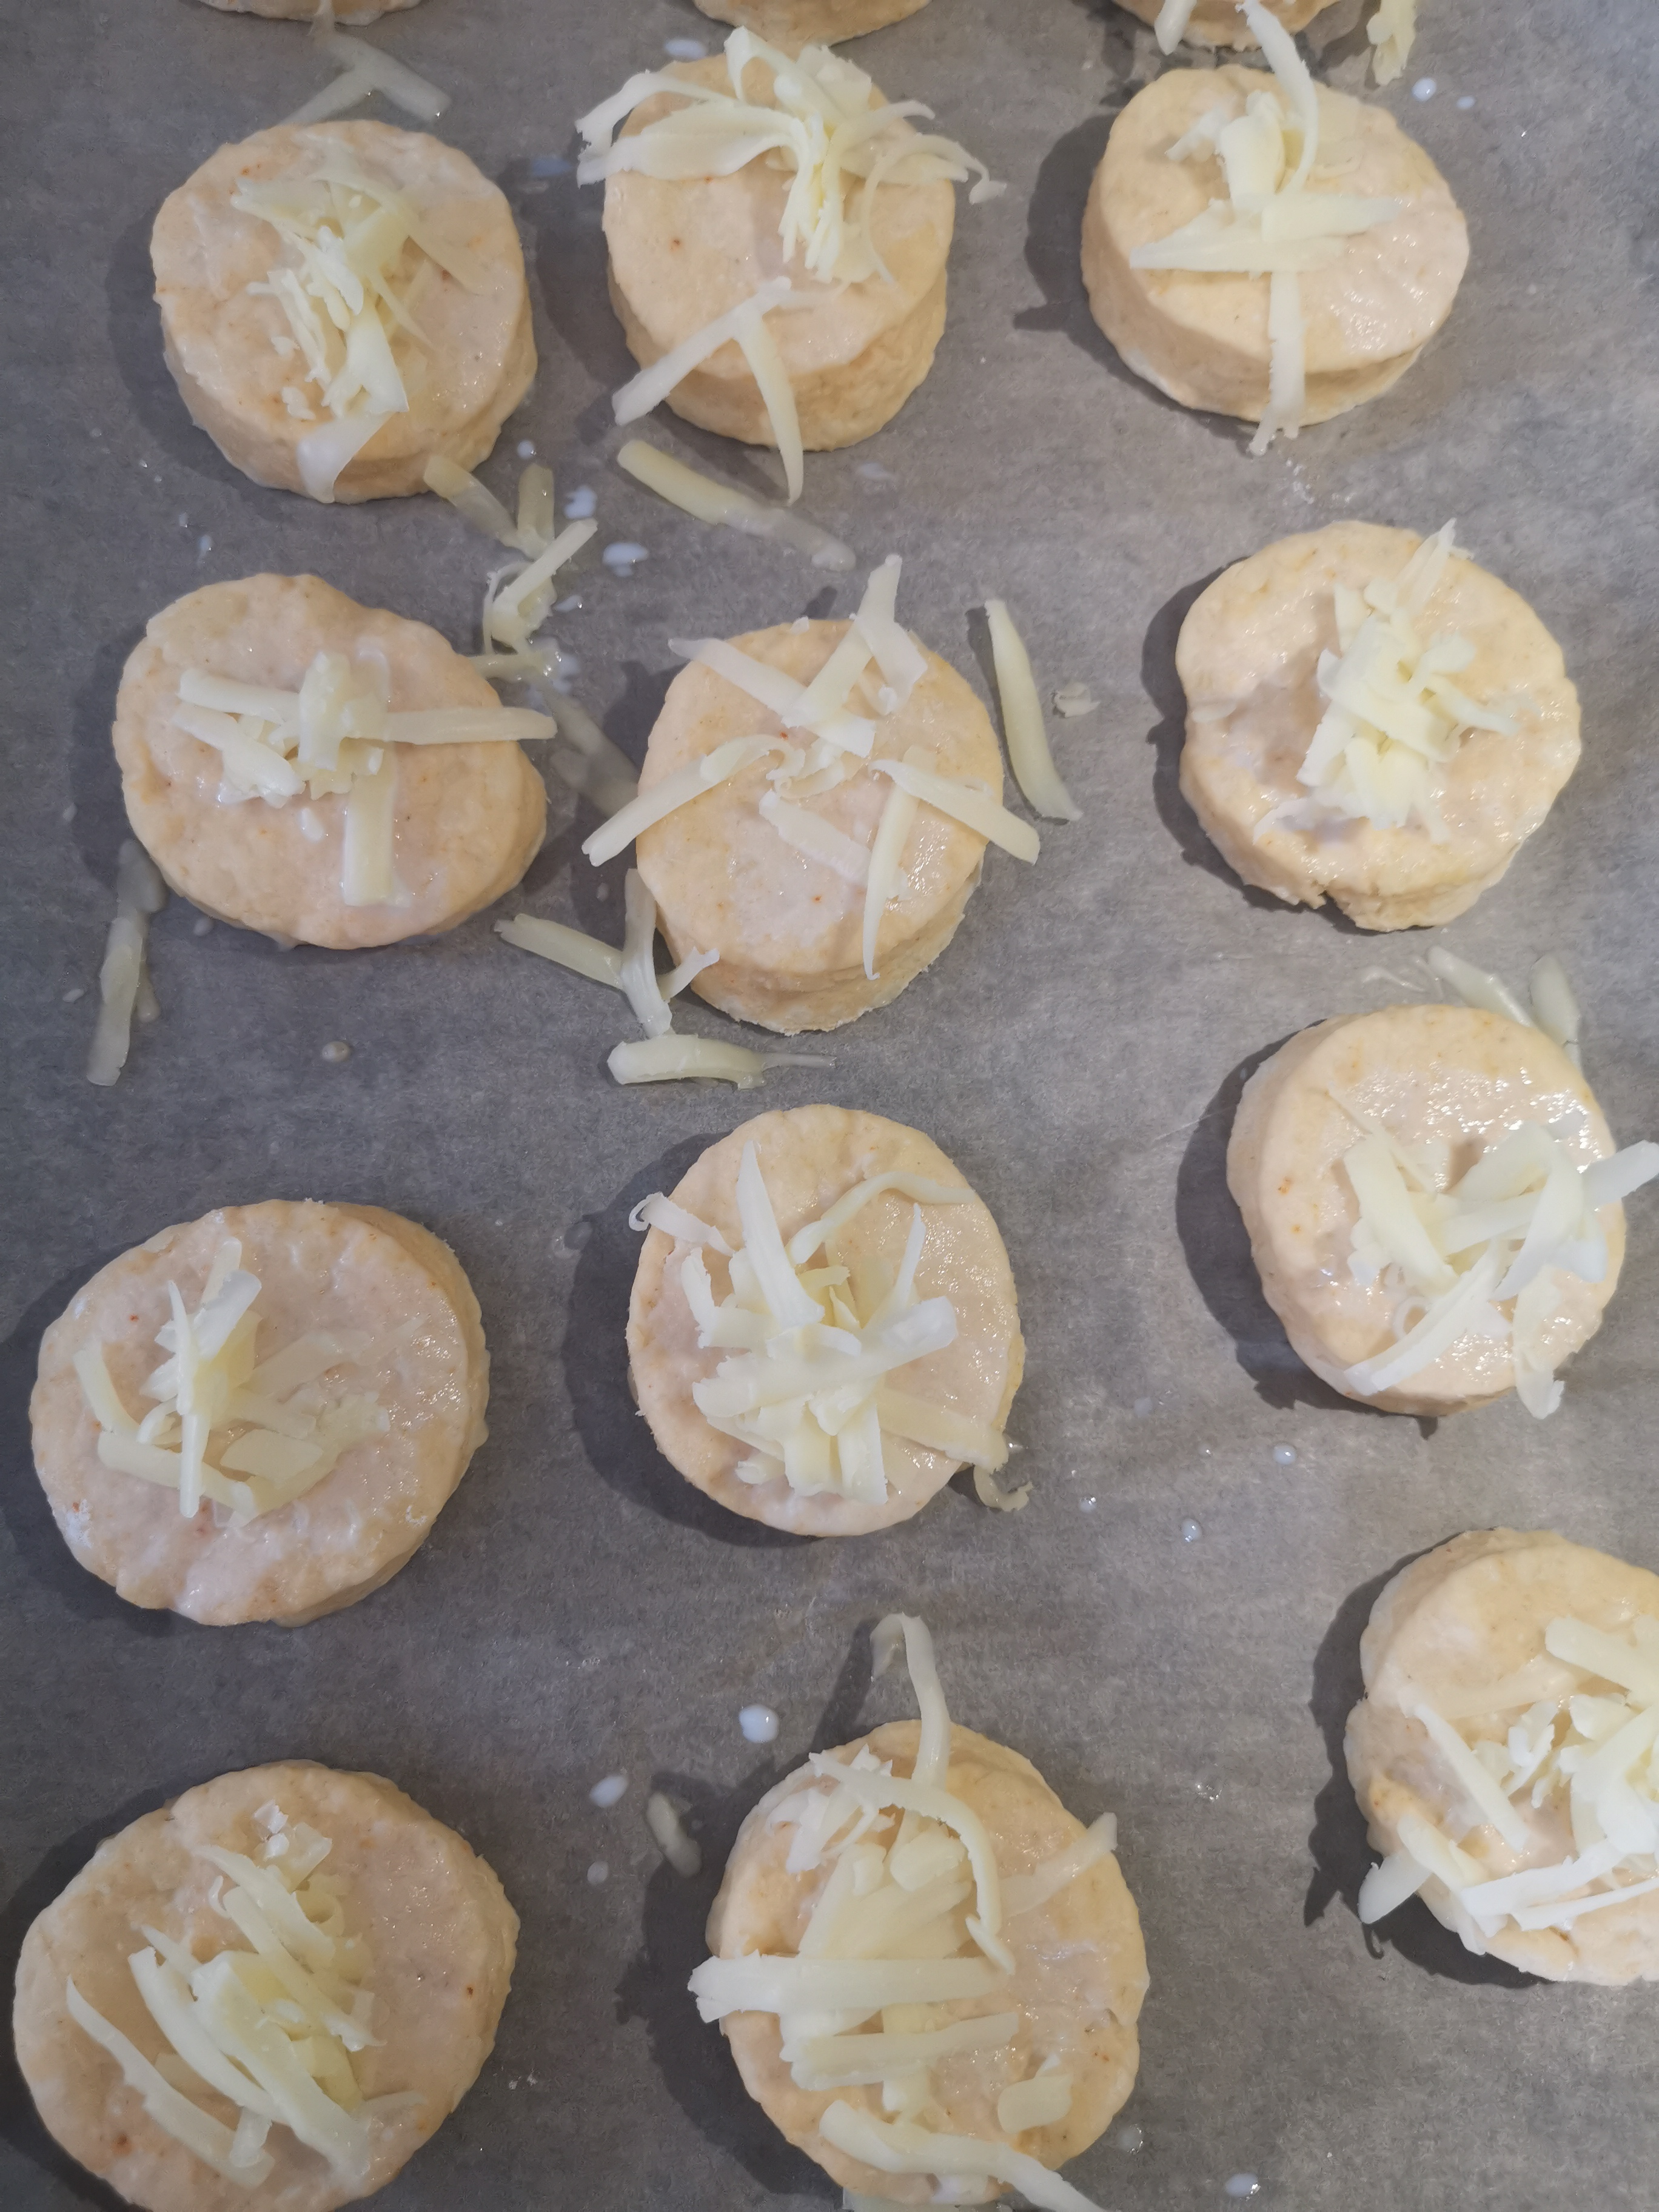
Slide the grease proof sheet and scones onto your pre-heated tray and bake until golden.
Using your chosen cookie cutter, cut out your shapes and place onto grease proof paper.
Glaze your scones with a little milk and sprinkle remaining cheese on top.

Slide 7
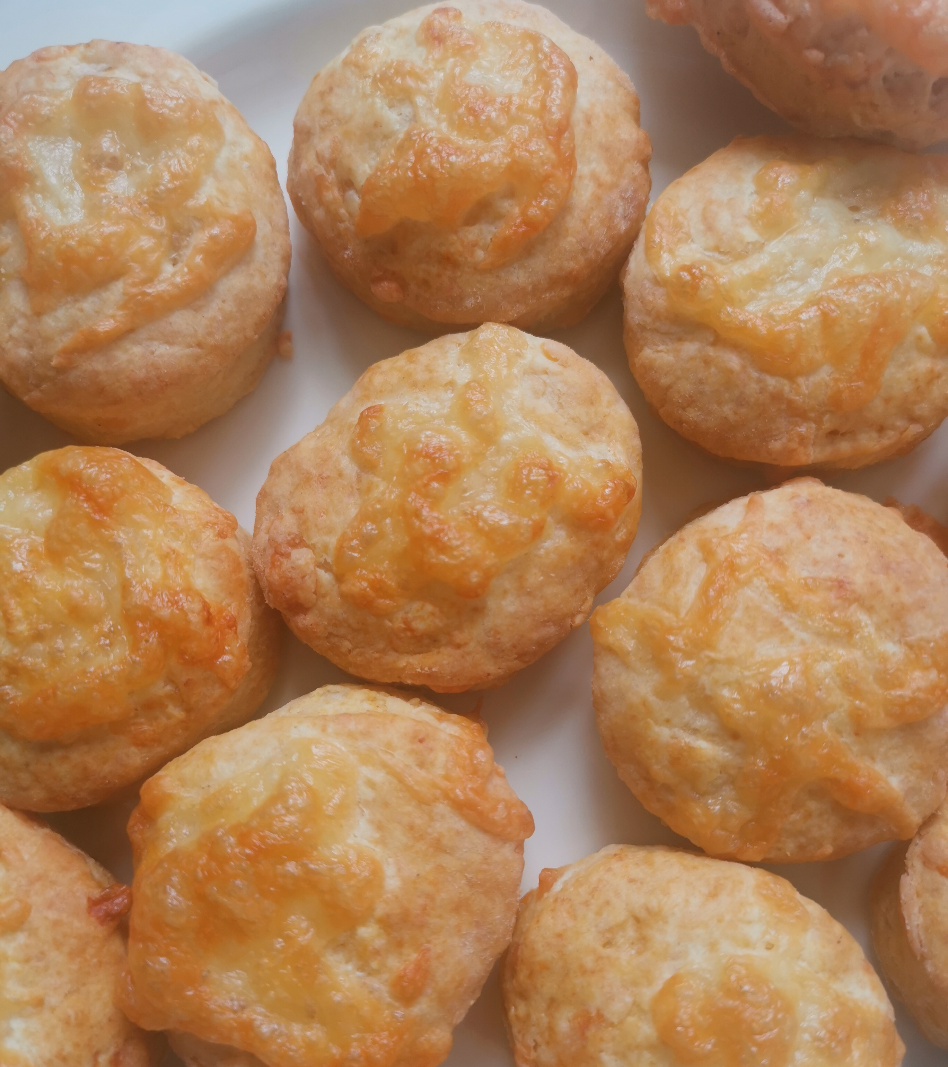
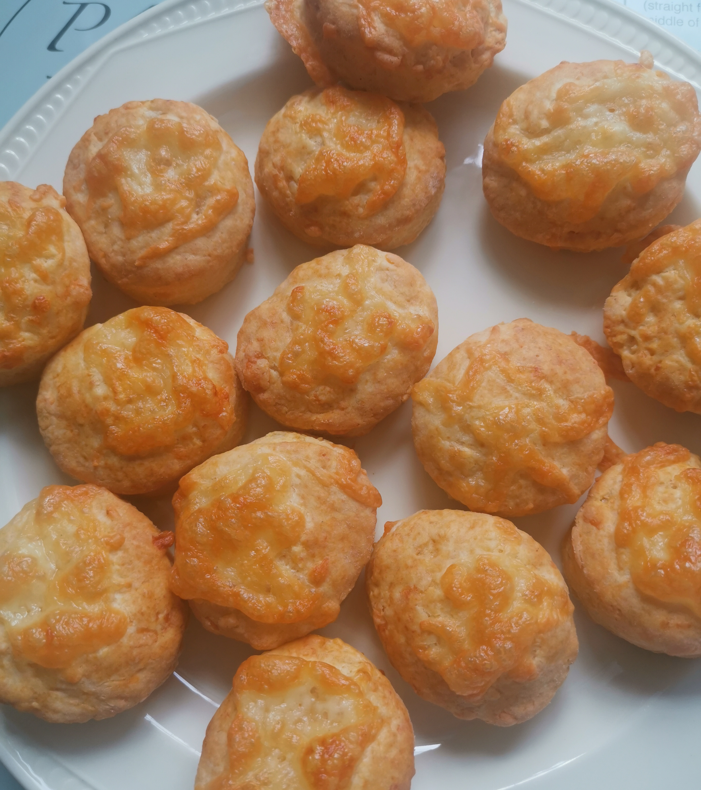
Wait a few minutes for them to cool down then
ENJOY! ☺

Slide 8
Have a lovely weekend!
See you back on Zoom on Monday ☺

