Slide 1
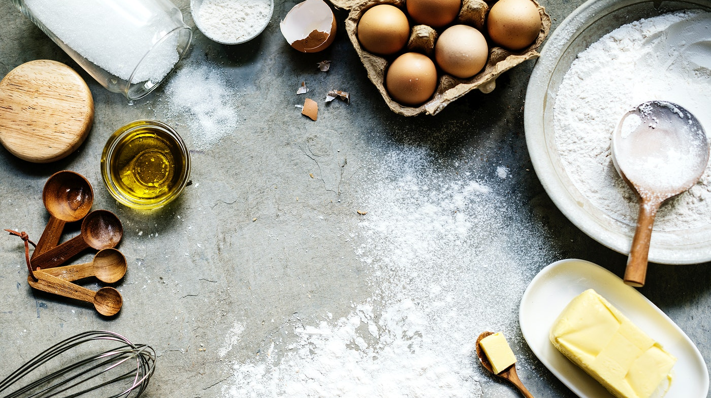
Chocolate Chip Tray Bake

Slide 2
What you’ll need
Cake batter:
- 190ml oil
250g plain flour
80g cocoa powder
3 tsp. baking powder
Good pinch of salt
300g caster/light brown sugar
350ml milk
2 tsp. vanilla extract
2 large eggs
100g white chocolate chips/fruit/nuts
Icing:
150g butter, cubed
200g icing sugar, sieved
4 tsp. cocoa powder
2 tbsp. milk
Equipment:
Large mixing bowl
Large measuring jug/bowl (wet ingredients)
Medium mixing bowl (for icing)
Hand whisk
Greased/lined deep baking tray
Spatula
Tablespoon
Grease and line your tin before we start ☺

Slide 3
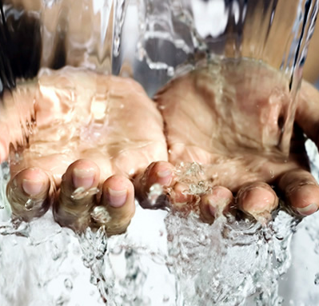
Remember to wash your hands!
Pre-heat oven to 180c/160c fan/Gas 4

Slide 4
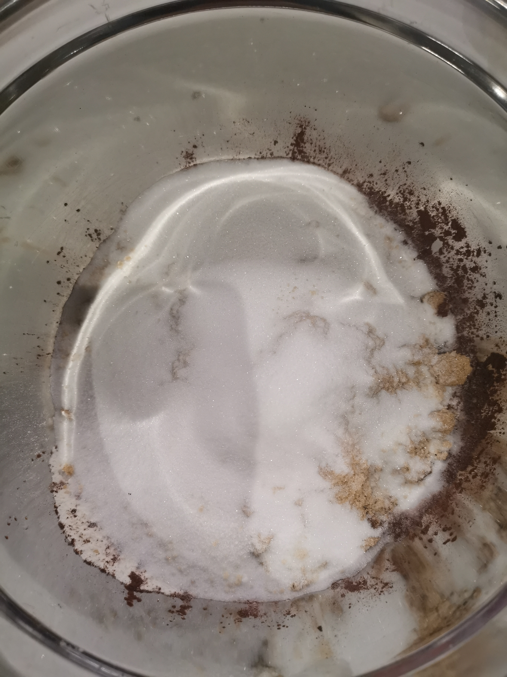
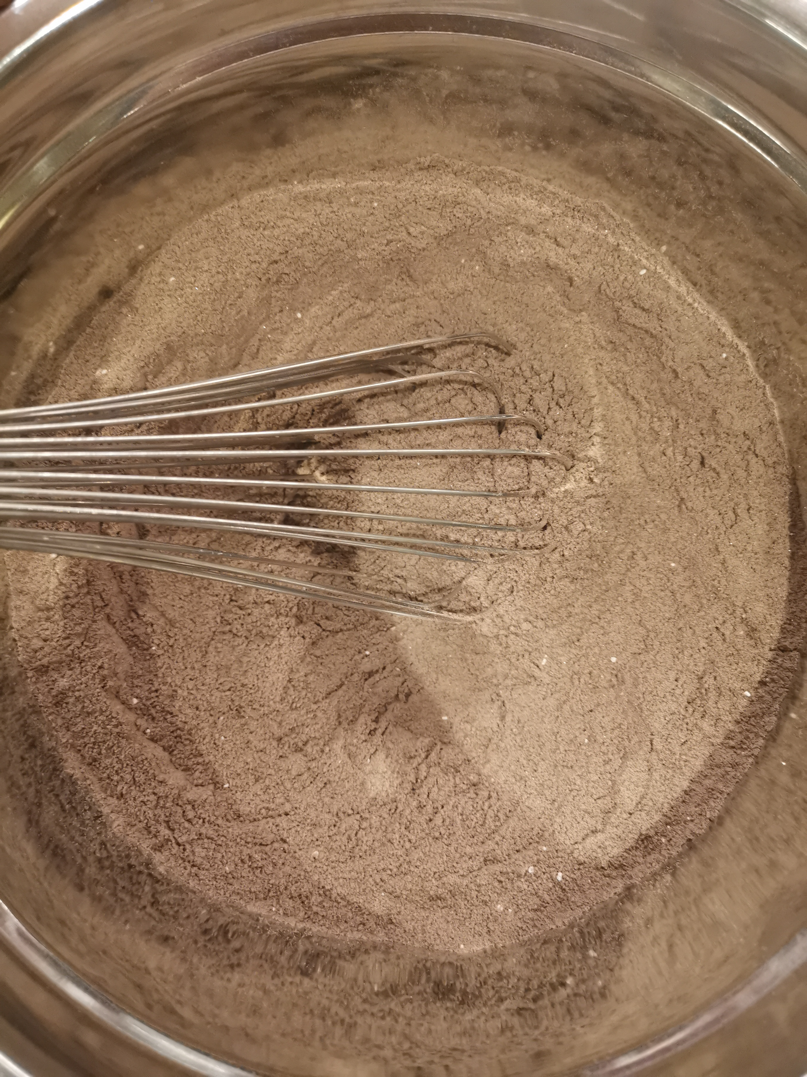
Into a large mixing bowl, sift in the flour, baking powder, salt and cocoa powder.
Now you can add the sugar. Whisk together, ensuring the ingredients are well combined.

Slide 5
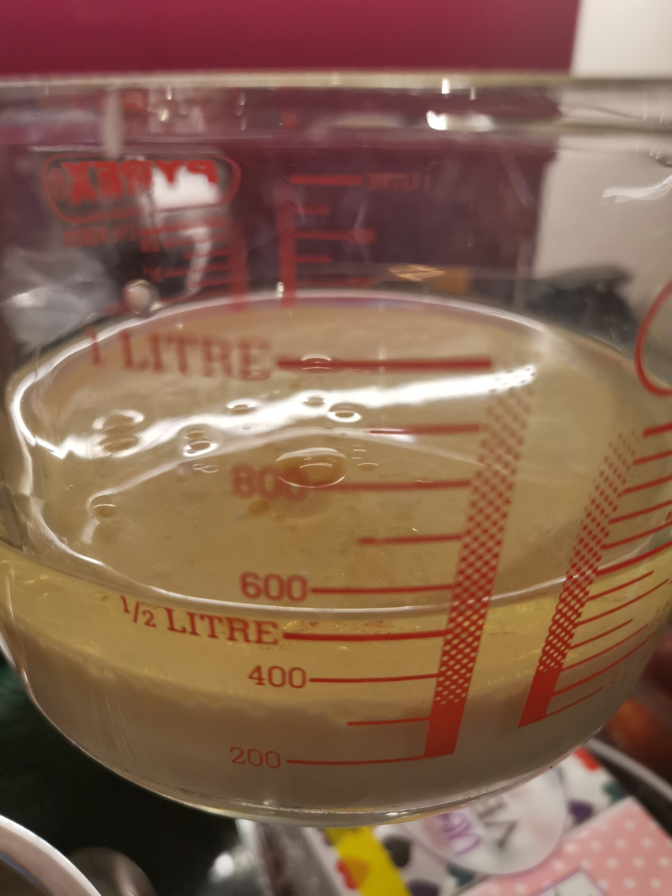
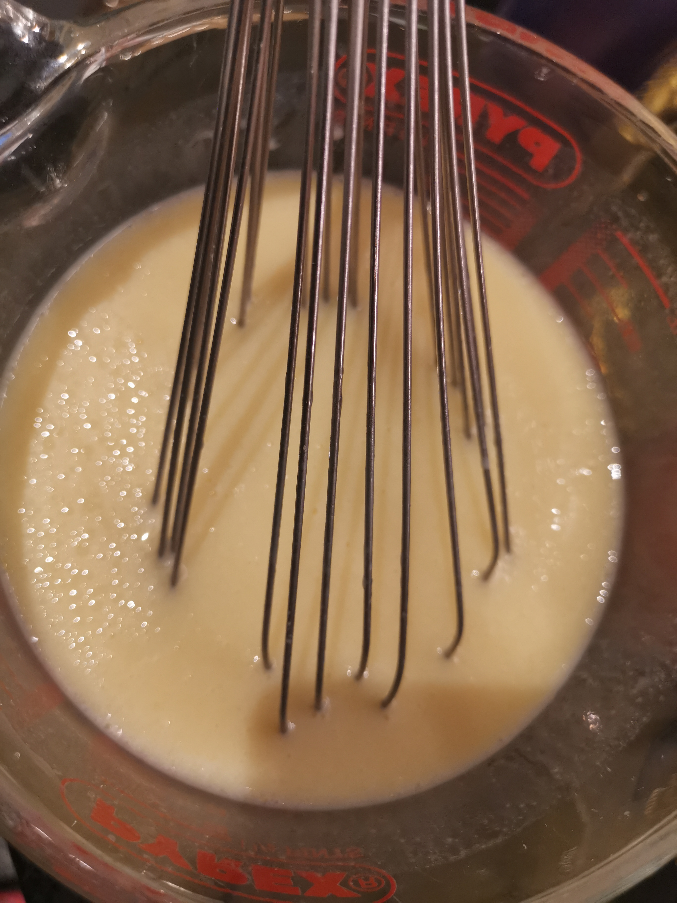
In a separate bowl or measuring jug, add the milk, oil and vanilla essence and give it a good mix.
Add both eggs and whisk making sure all of the ingredients have combined well.

Slide 6
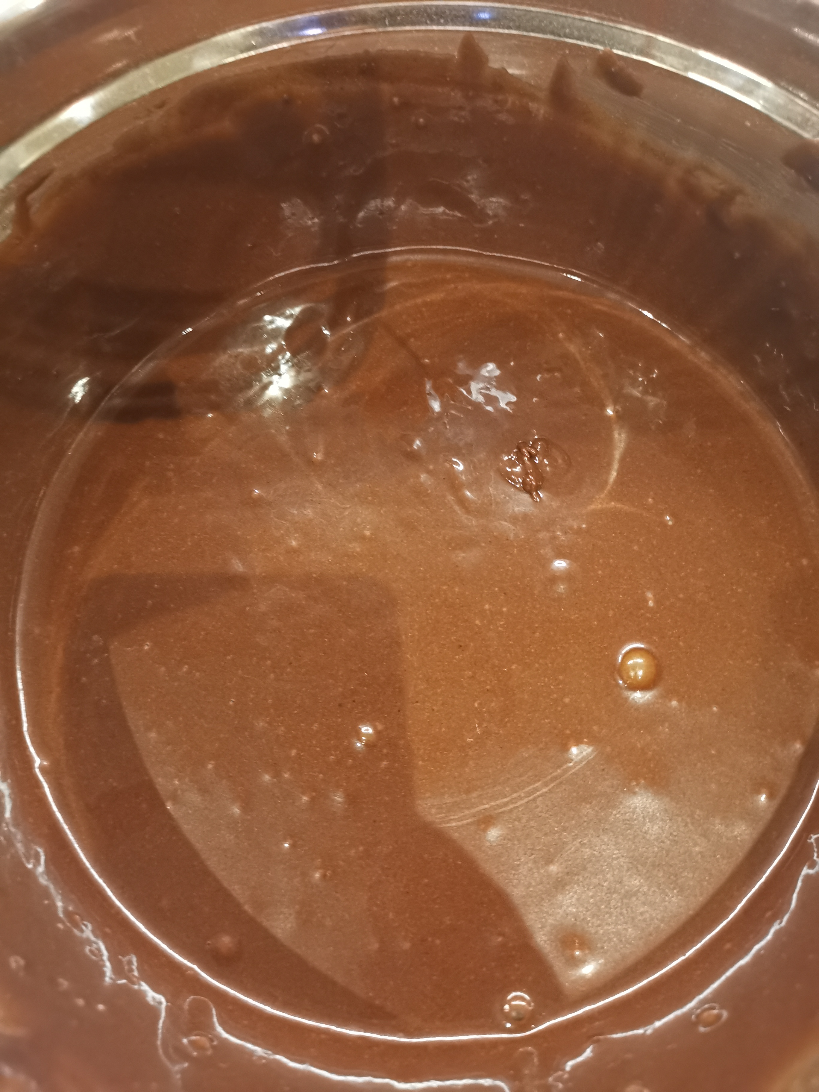
Pour the wet ingredients to the dry ingredients and whisk thoroughly, getting rid of any lumps of flour or sugar.

Slide 7
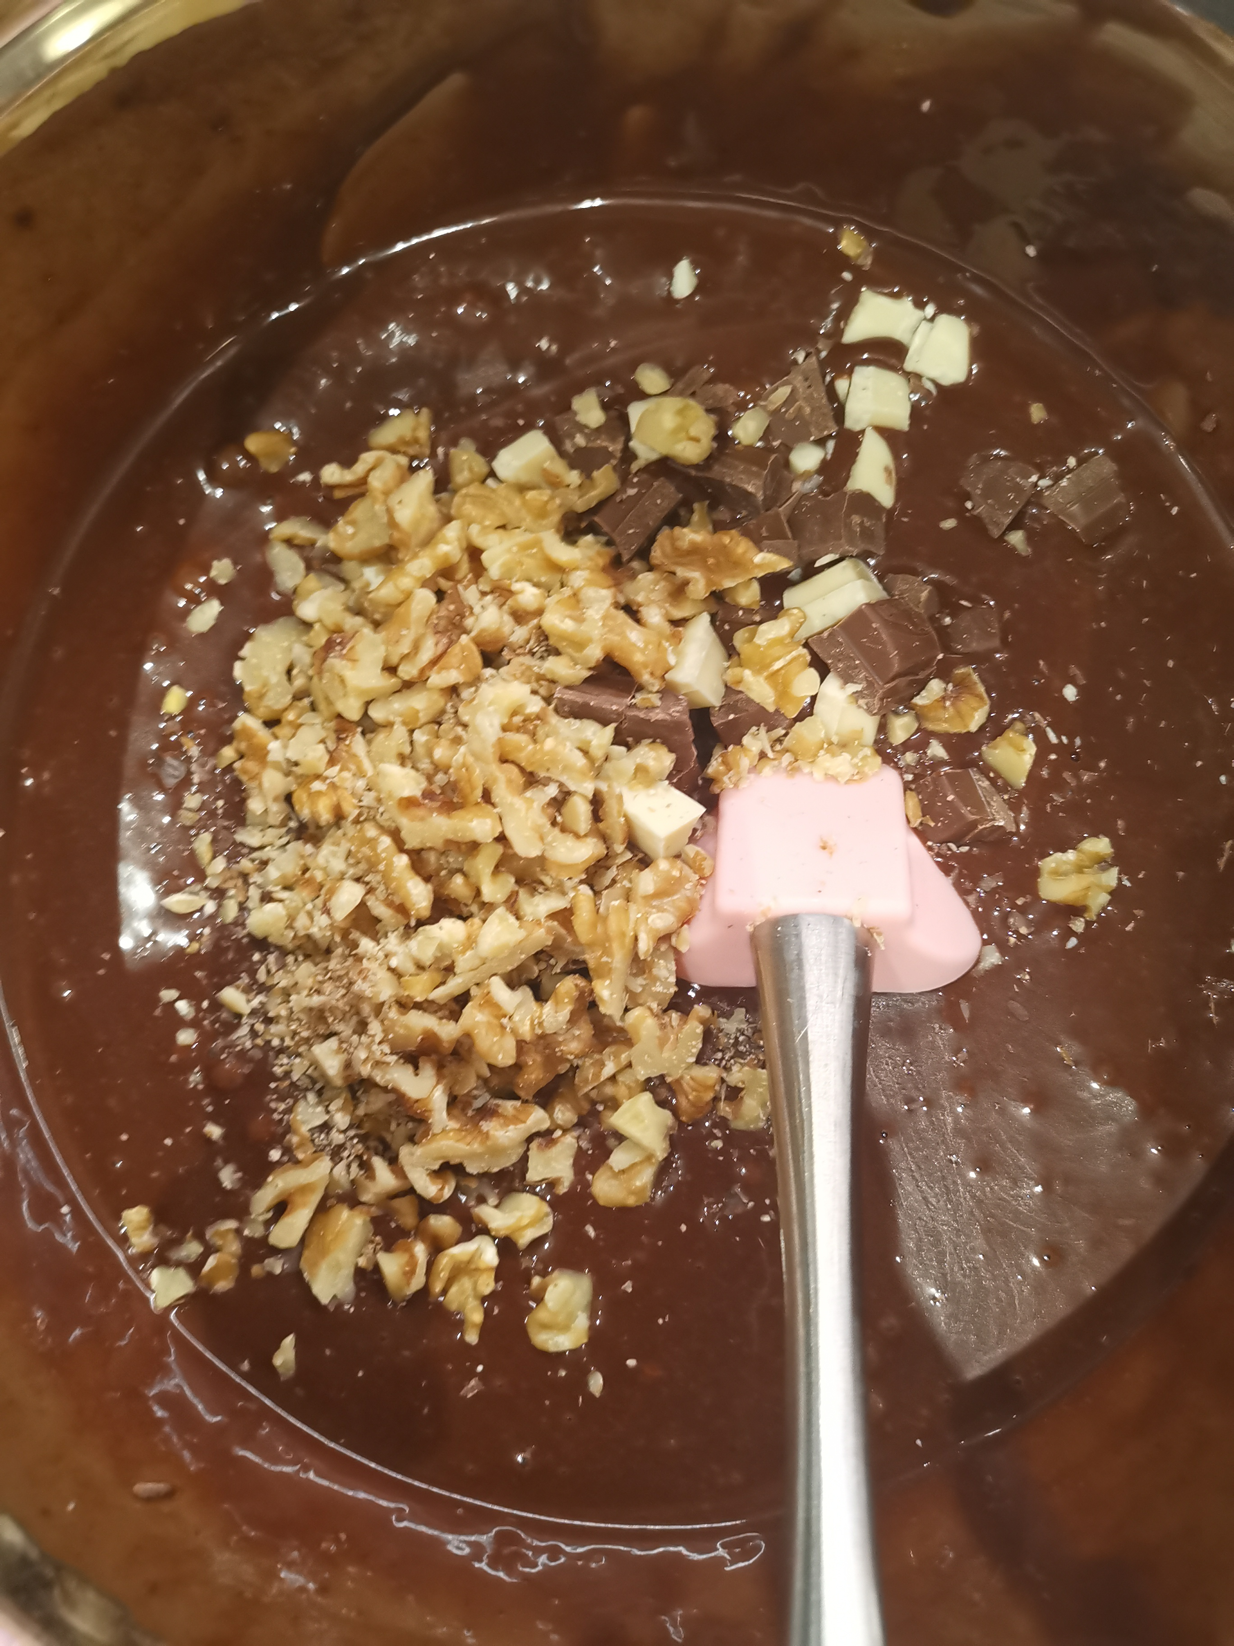
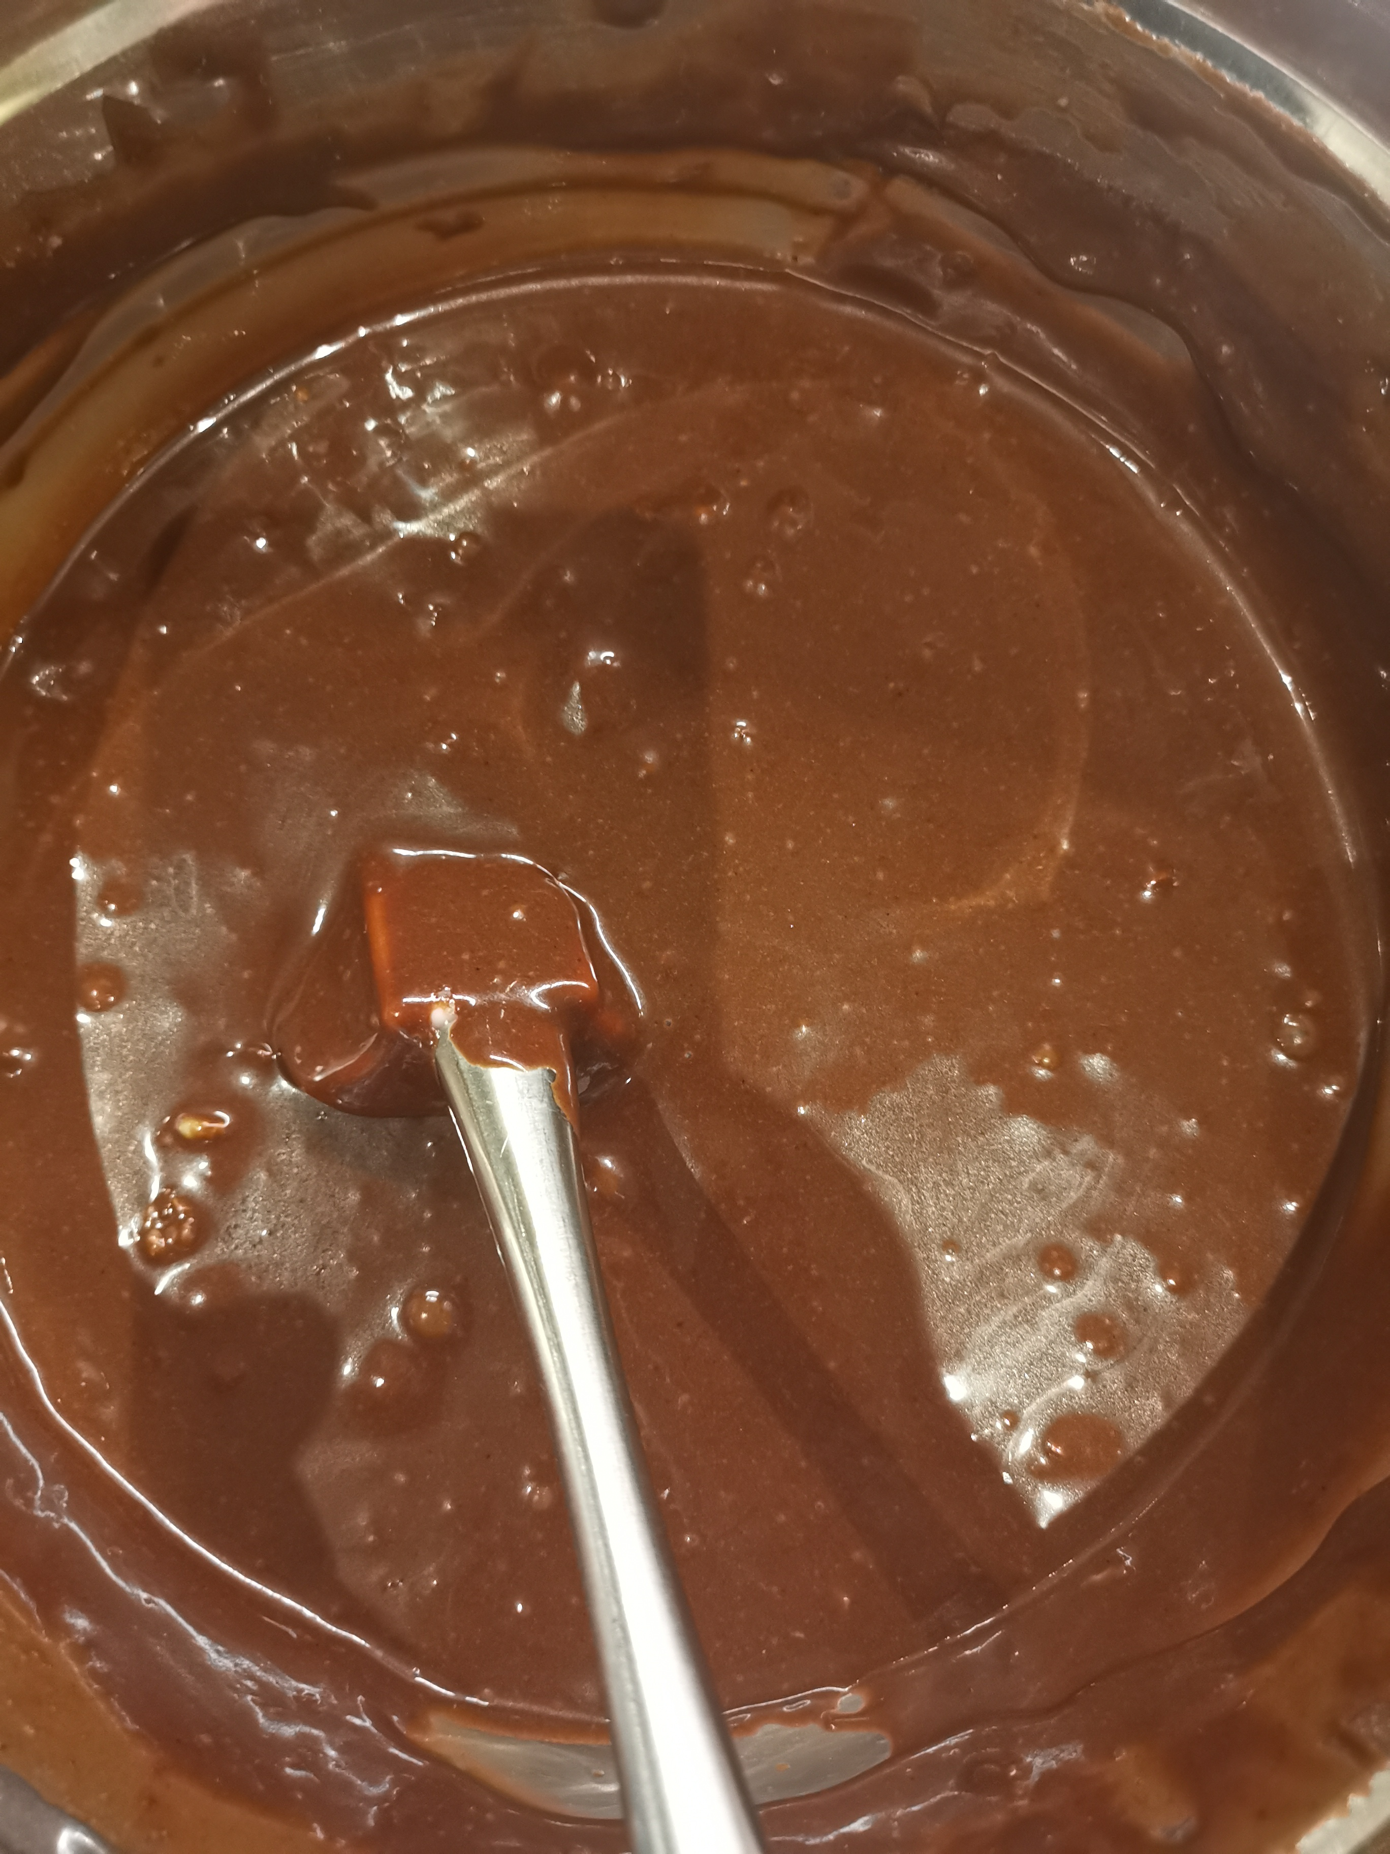
Add your chocolate chips/nuts and fold in using a spatula.

Slide 8
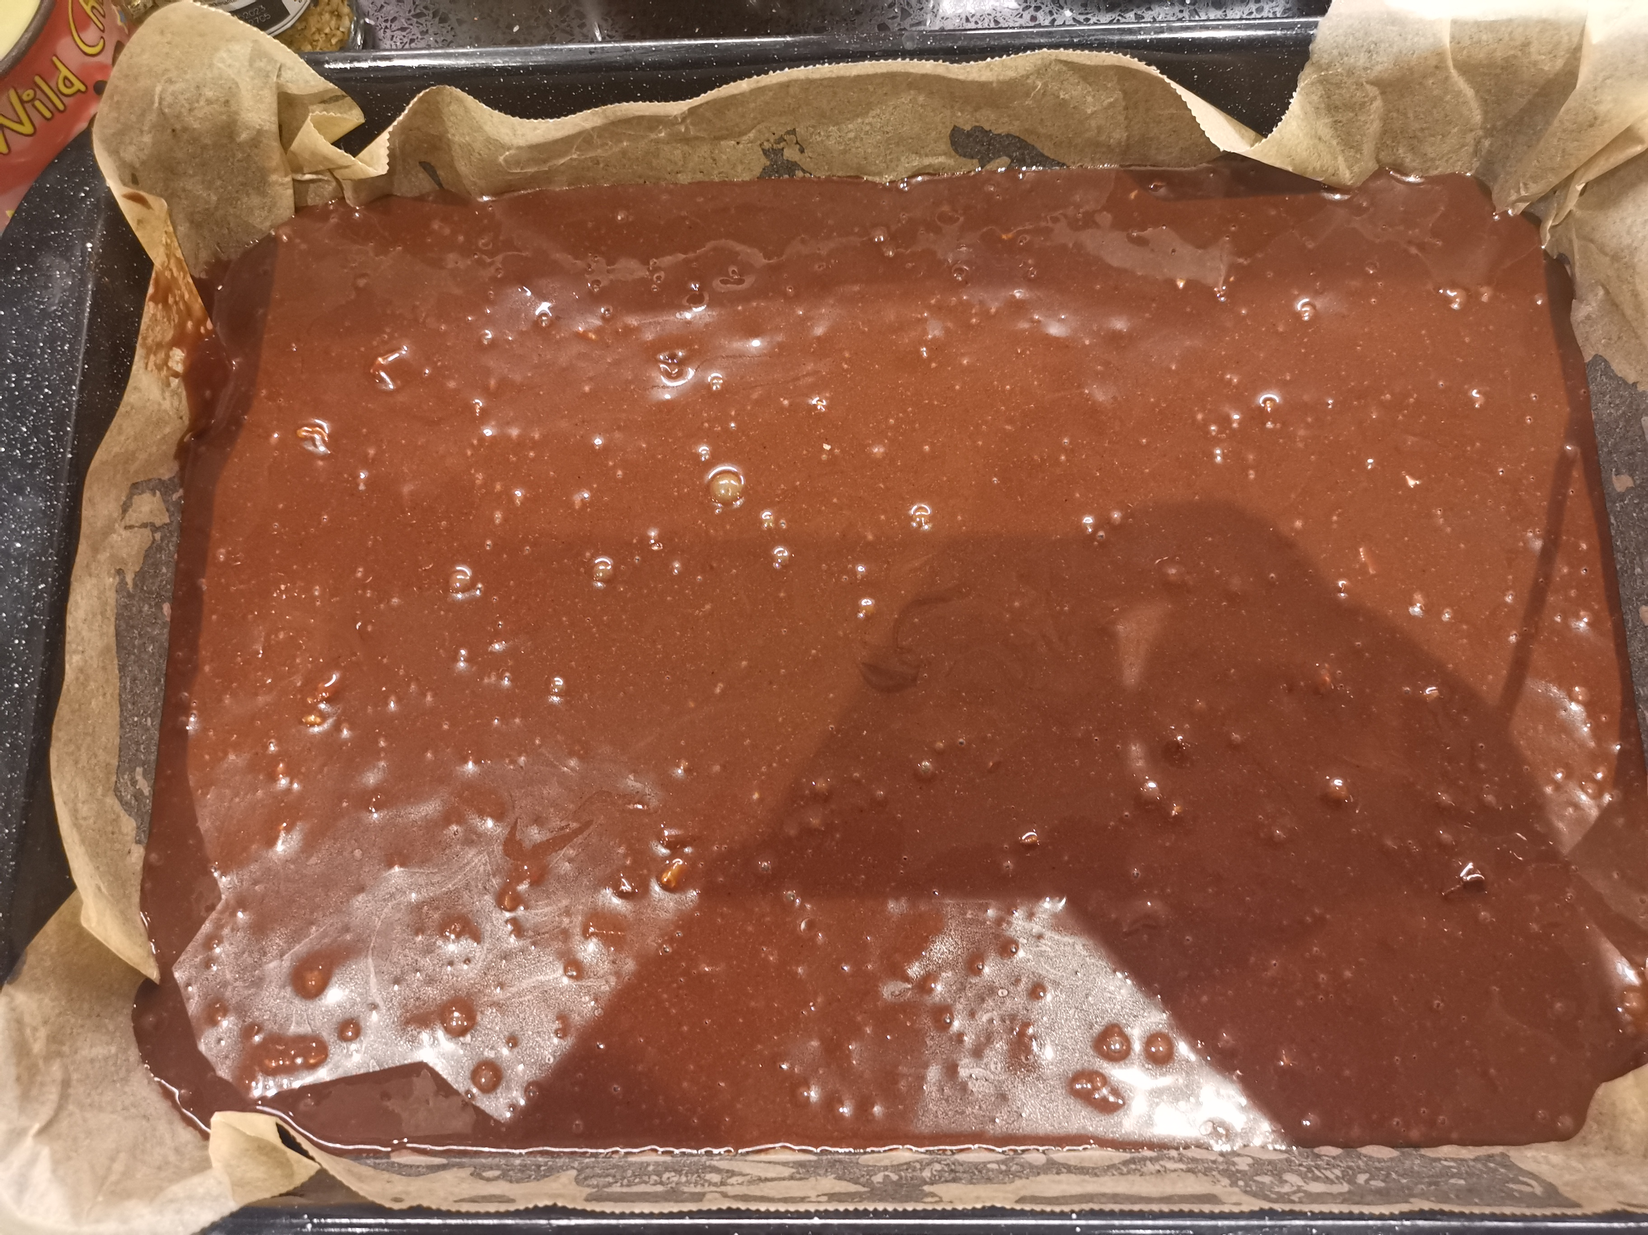
Pour your mixture into your greased/lined tin and bake for around 25-30 minutes, or until a skewer or toothpick comes out clean.

Slide 9
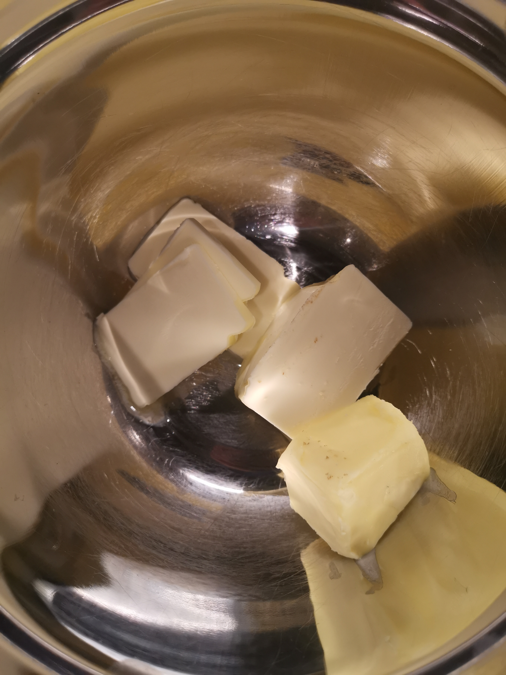
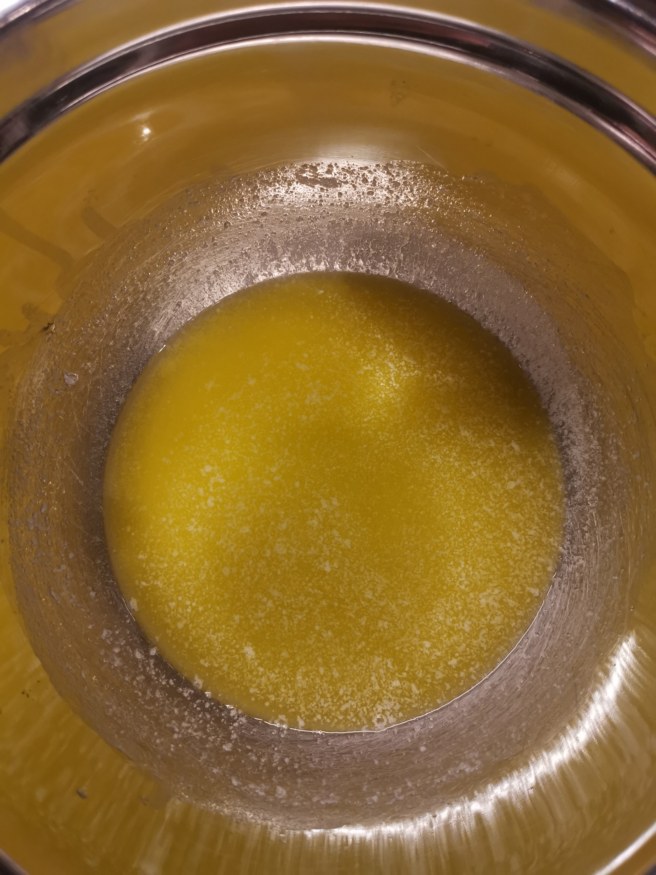
Melt 150g of unsalted butter in the microwave or over a bain-marie.

Slide 10
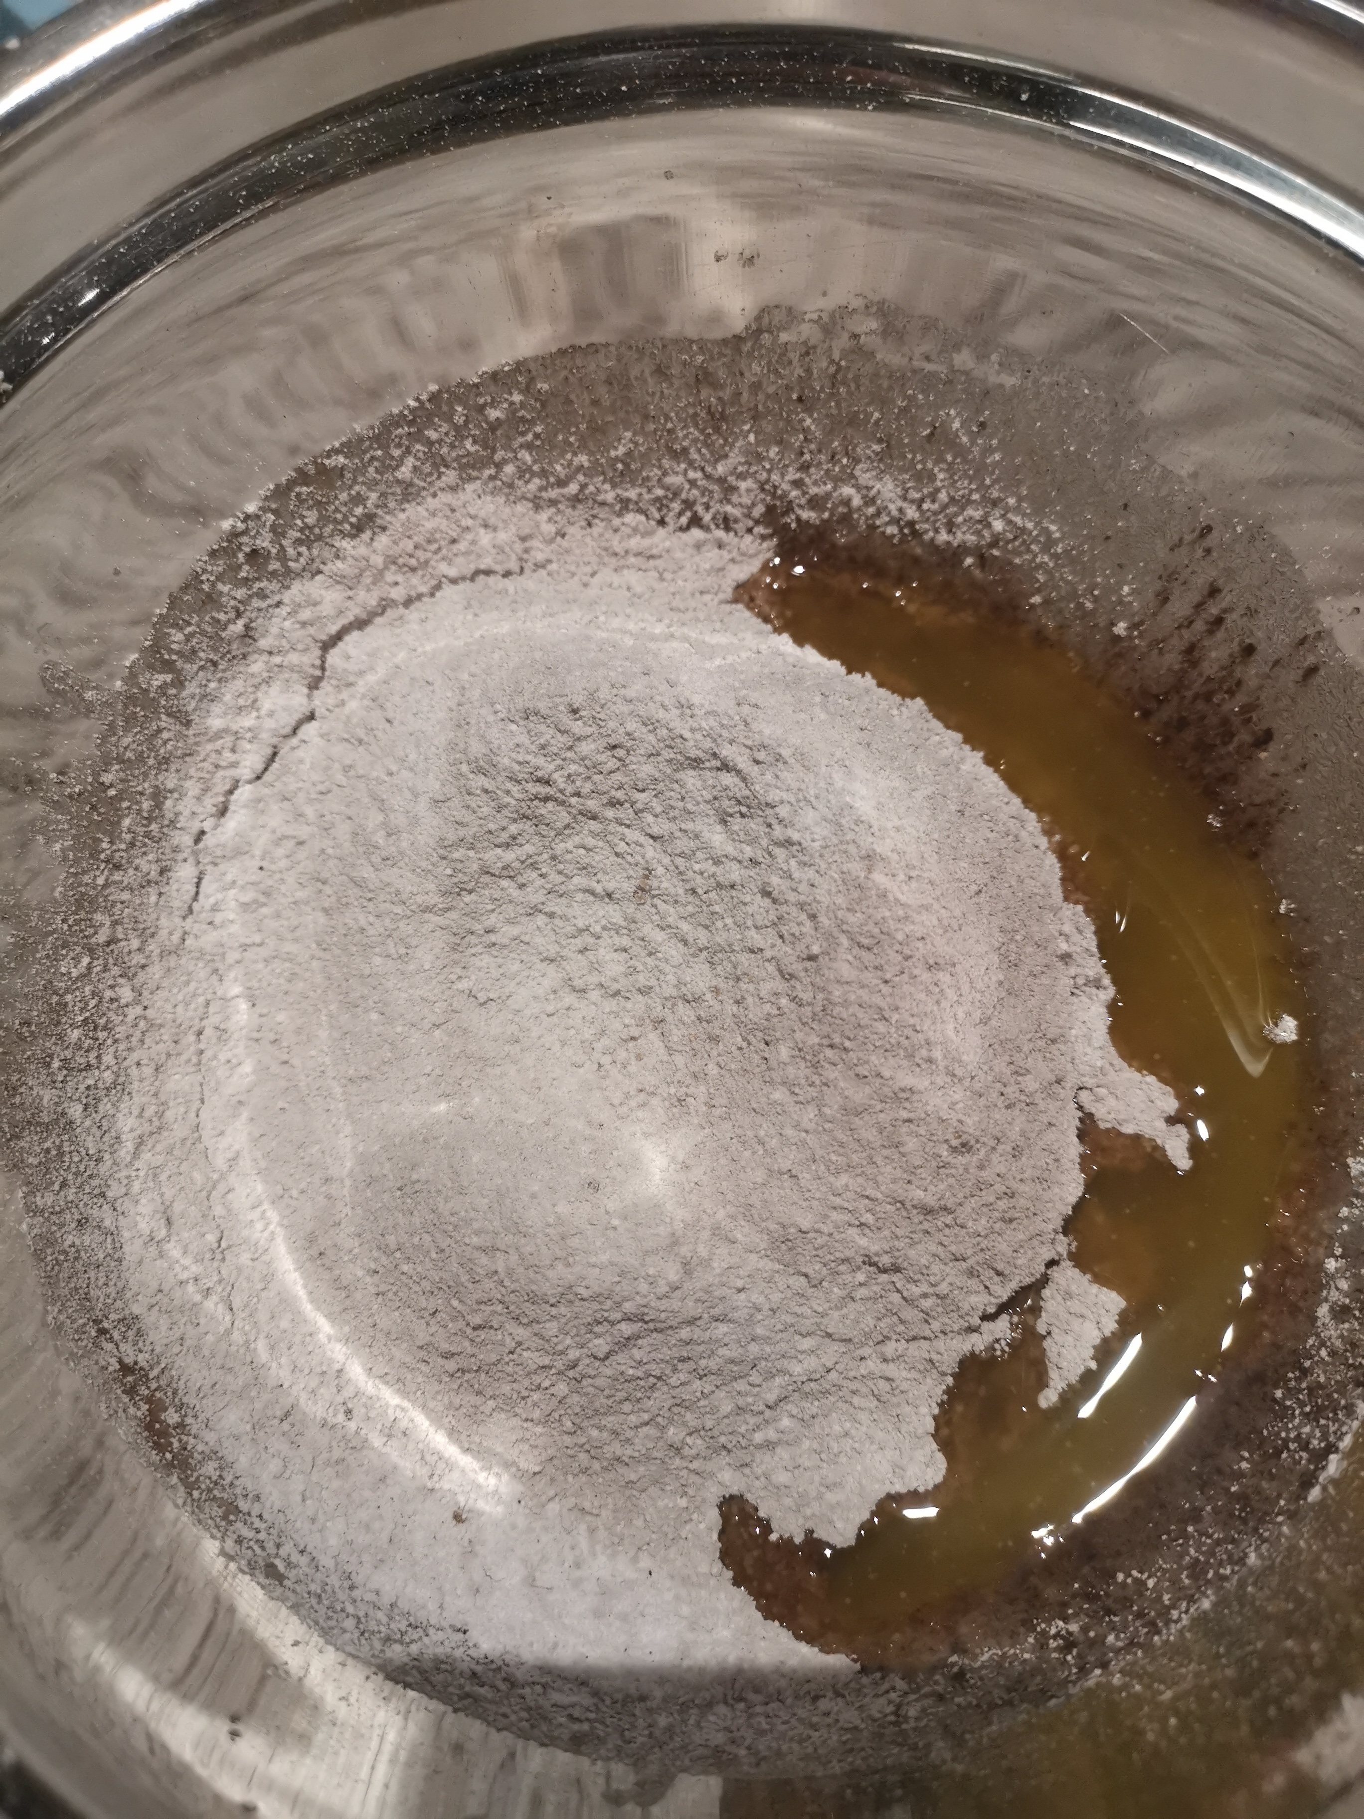
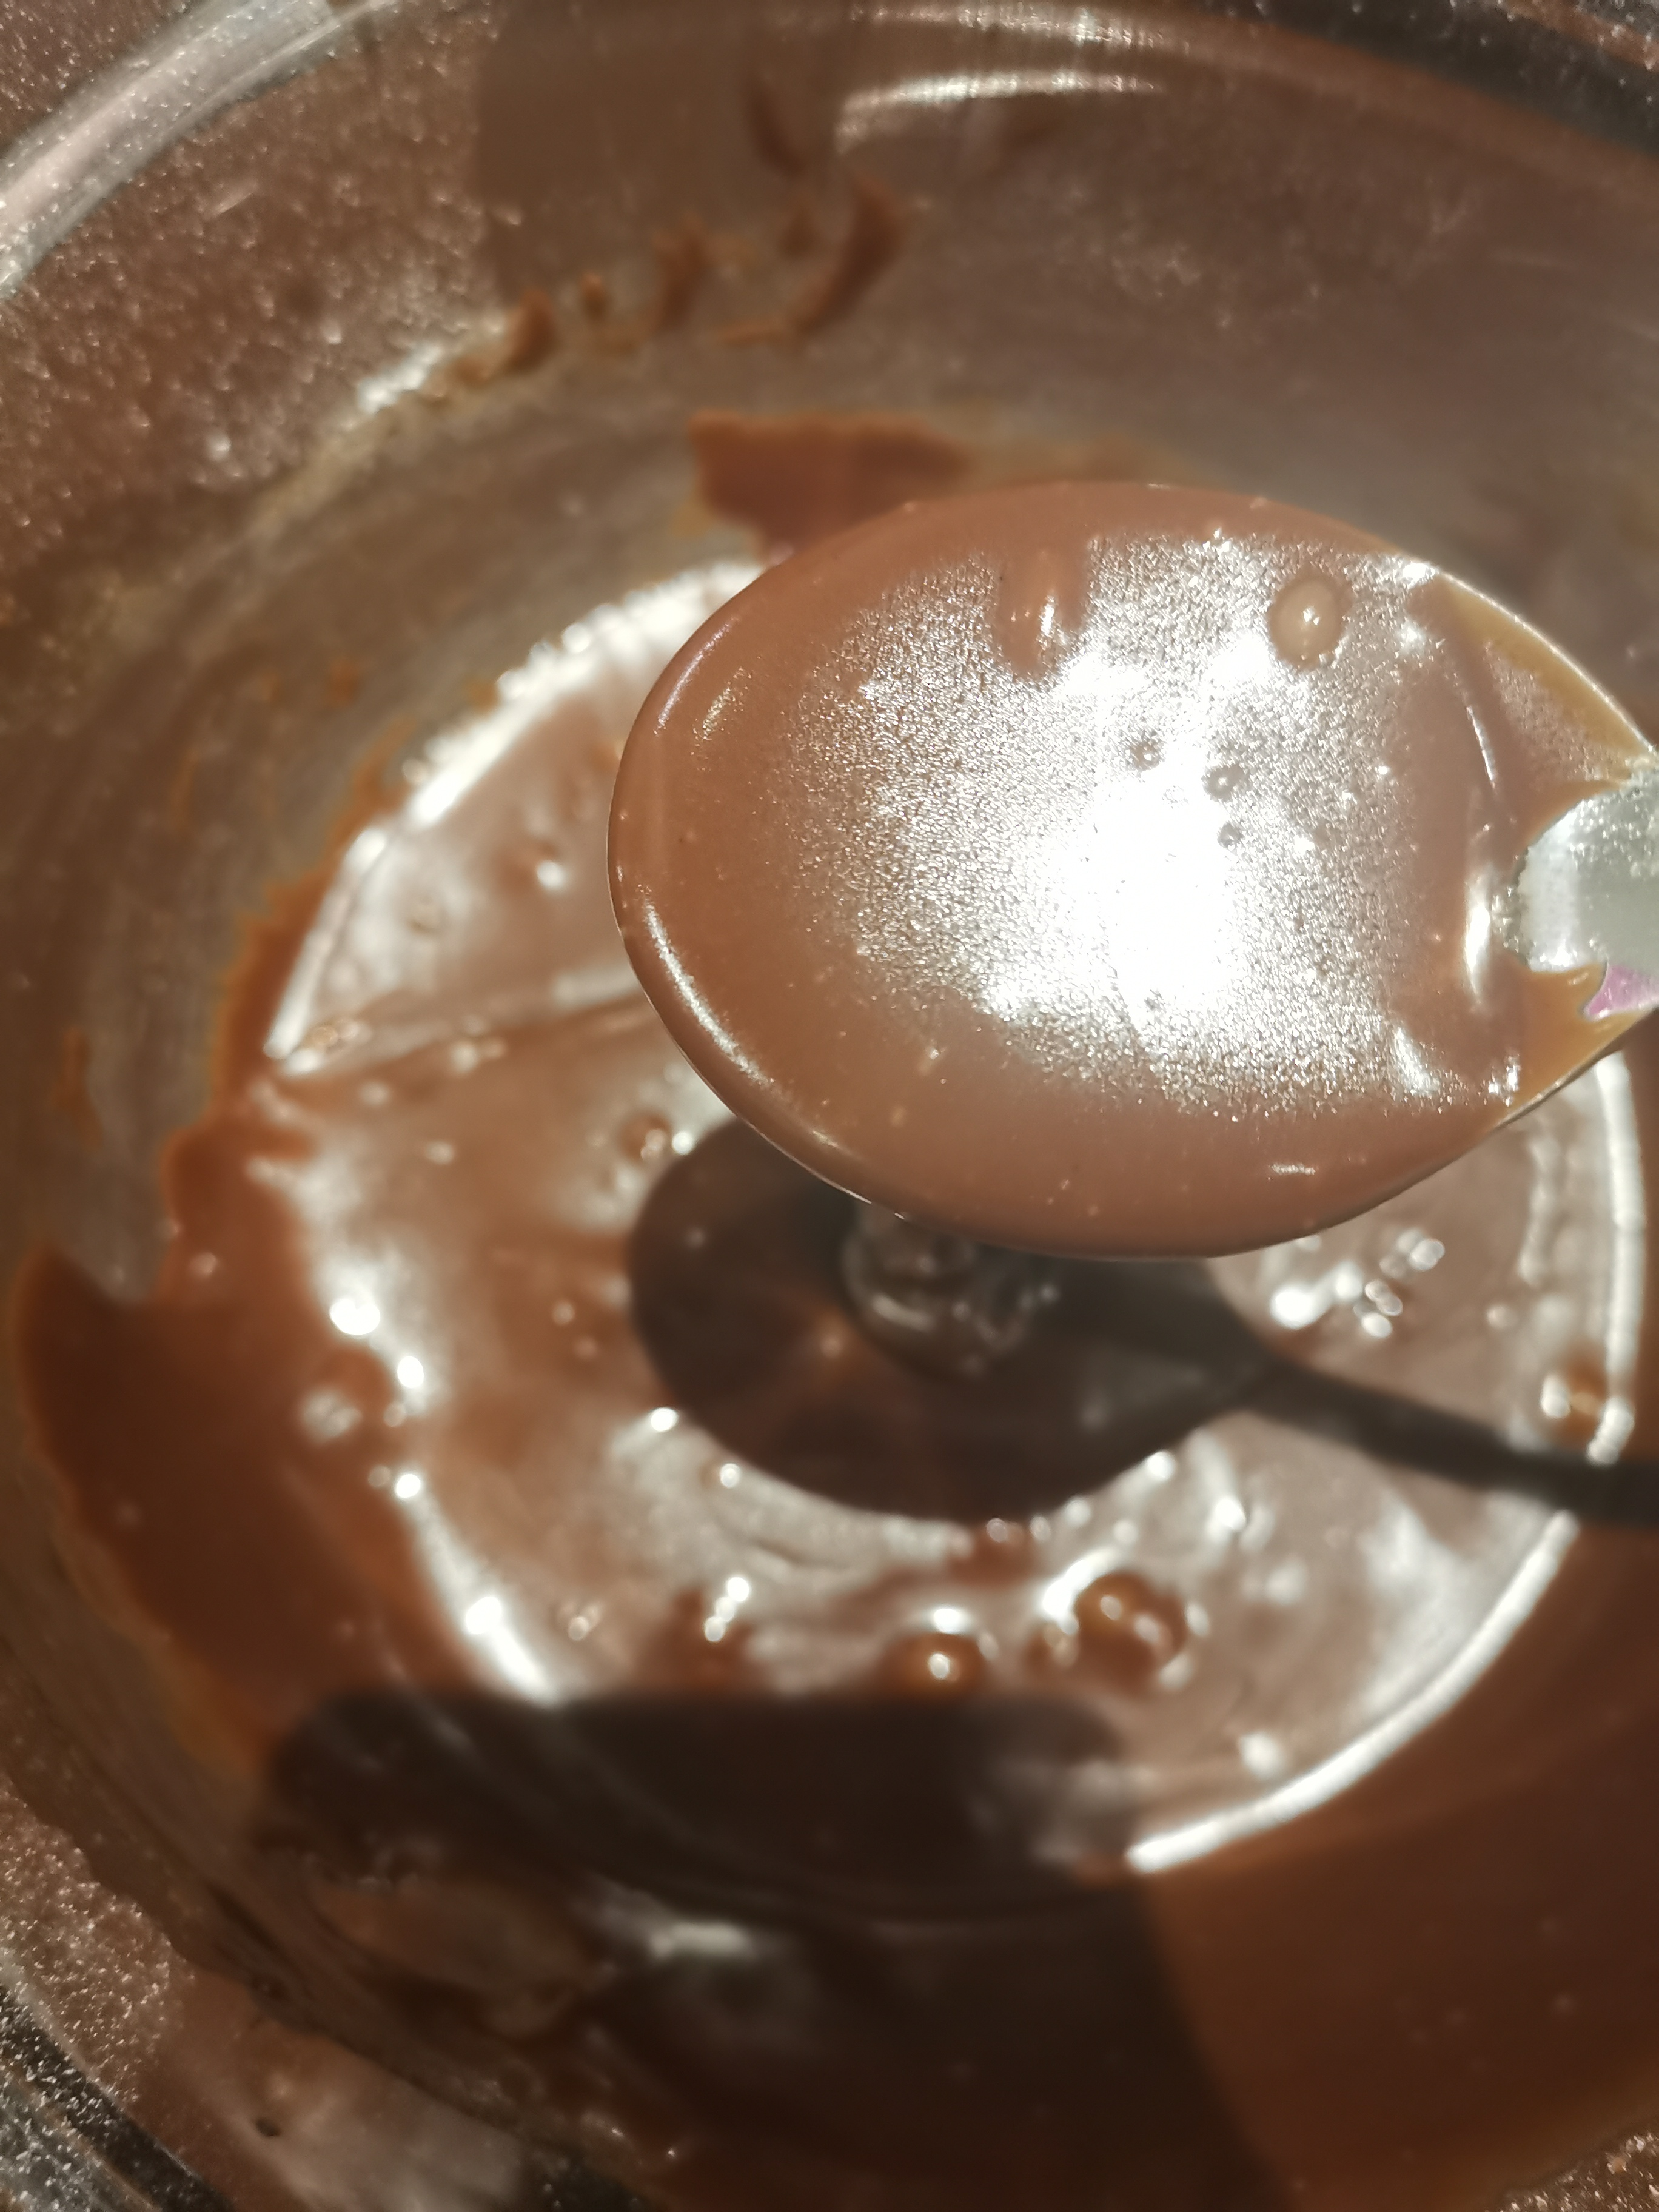
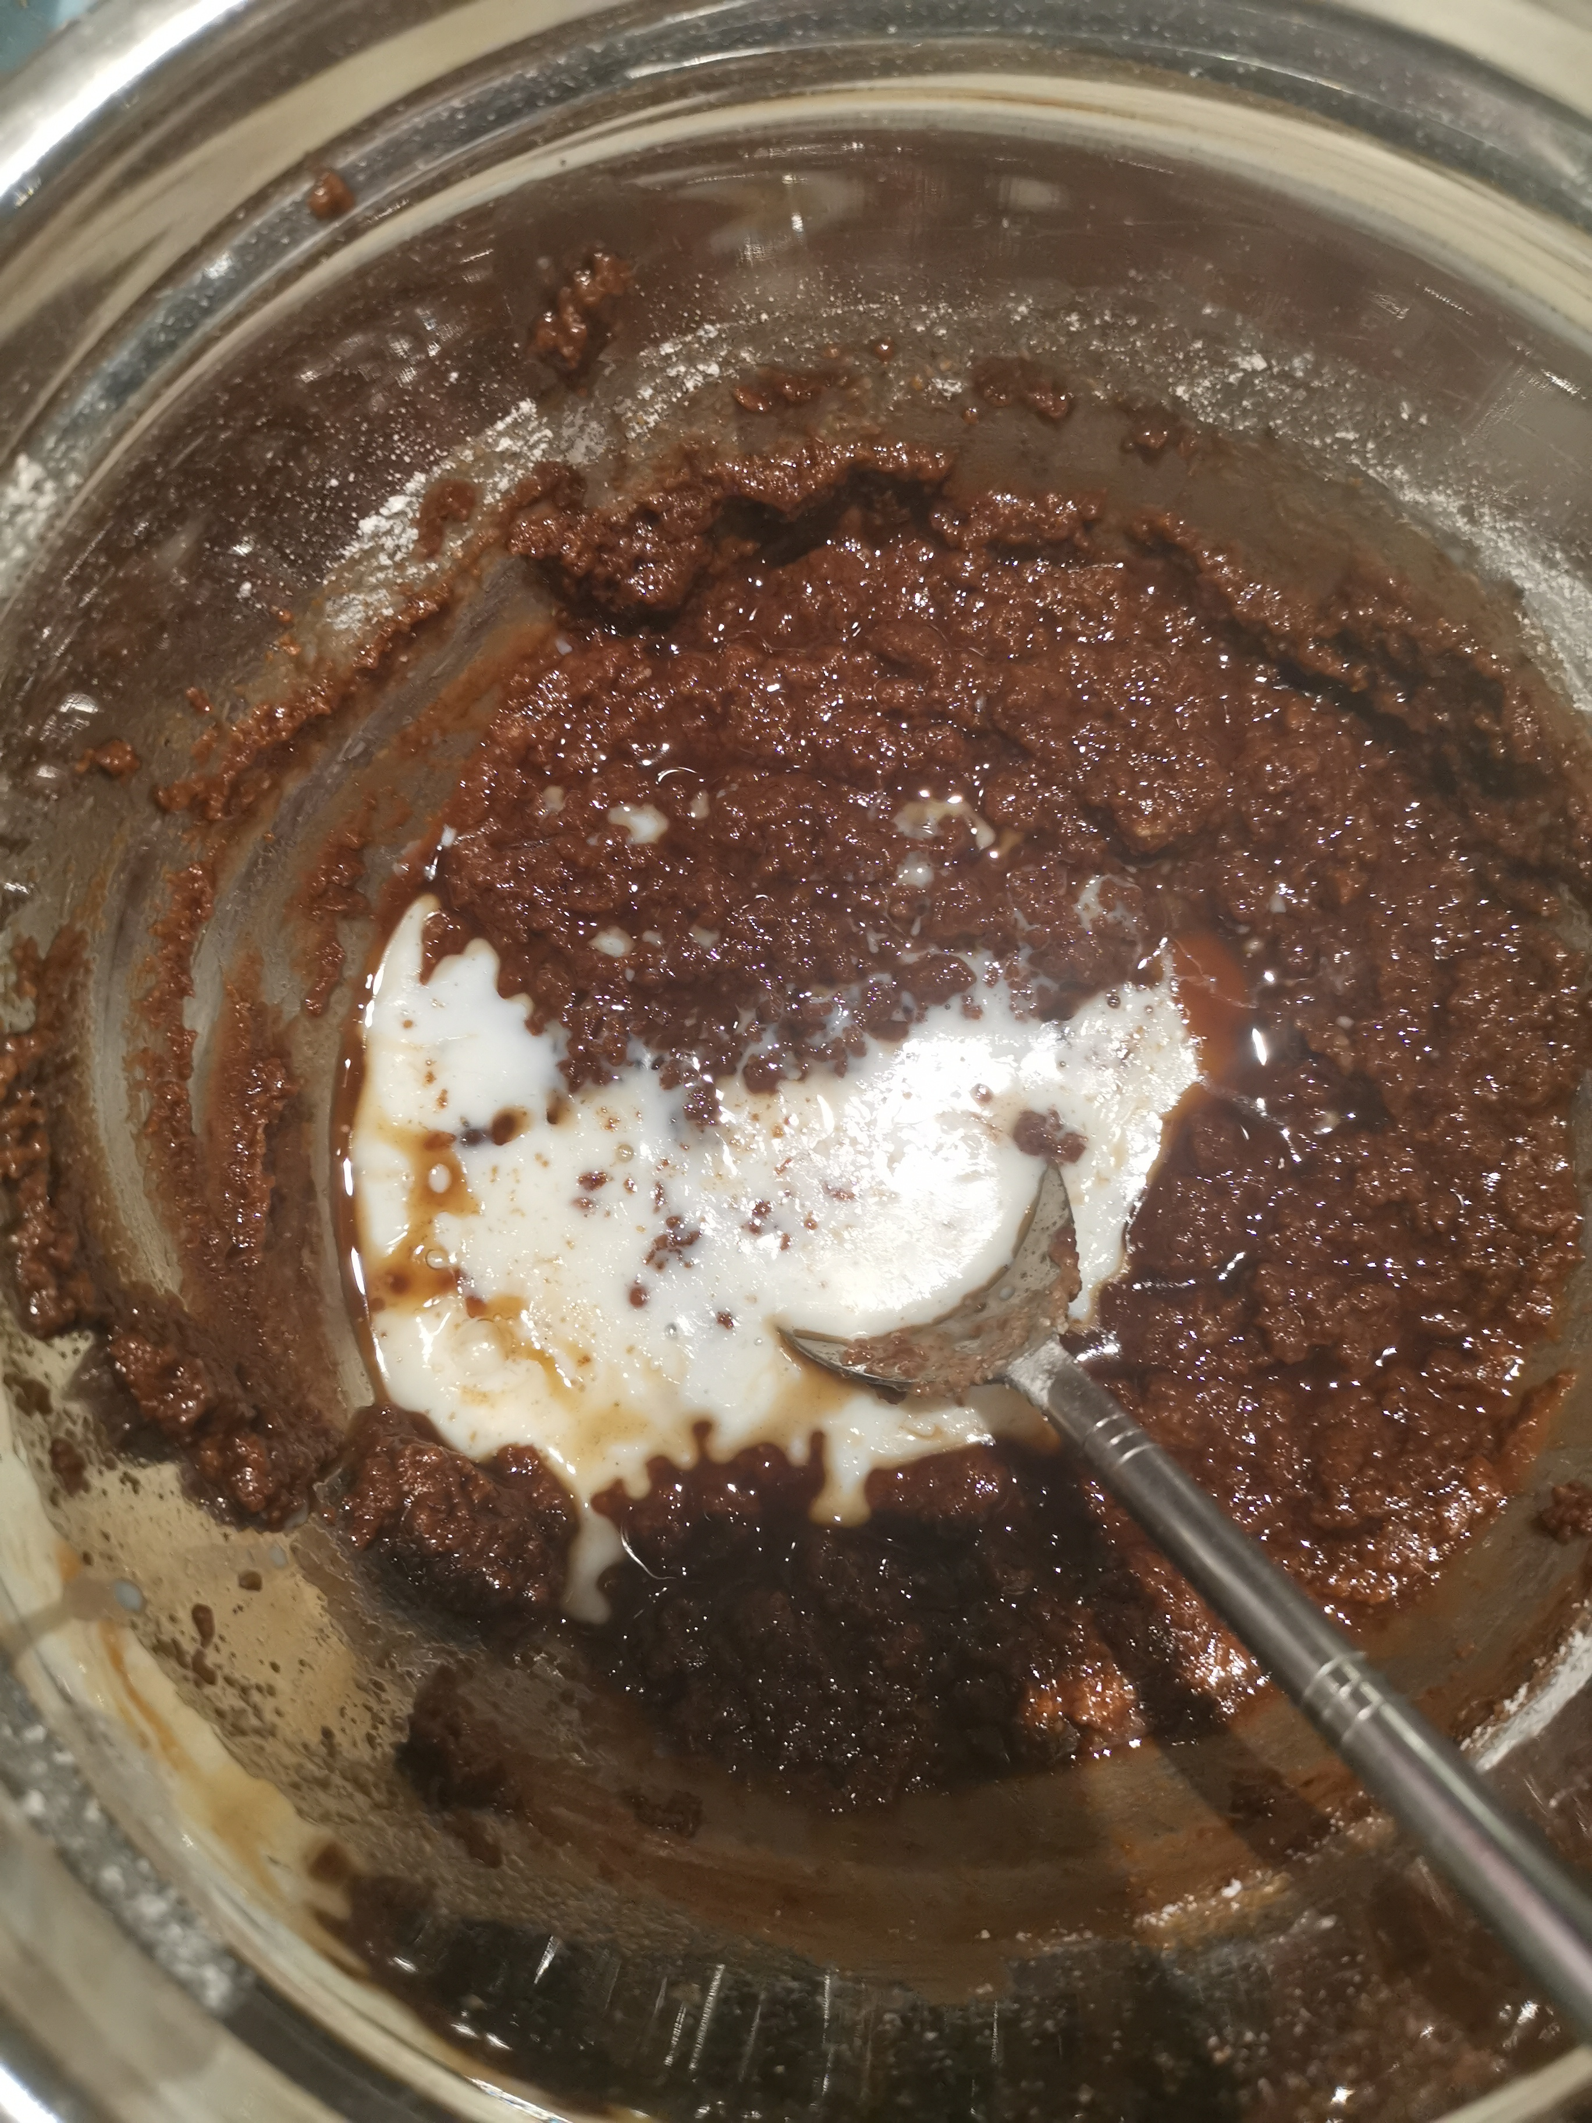
Sift in 200g powdered sugar and 4 tsp. cocoa powder. Mix together well with a tablespoon.
The ganache may seem very runny, but it will thicken up a little as it cools.
If the icing has thickened too much before the cake has cooled, reheat it slightly to make it easier to pour.
It will start to curdle but don’t worry. Add in 2 tbsp. milk and vigorously mix until you get a smooth ganache.

Slide 11
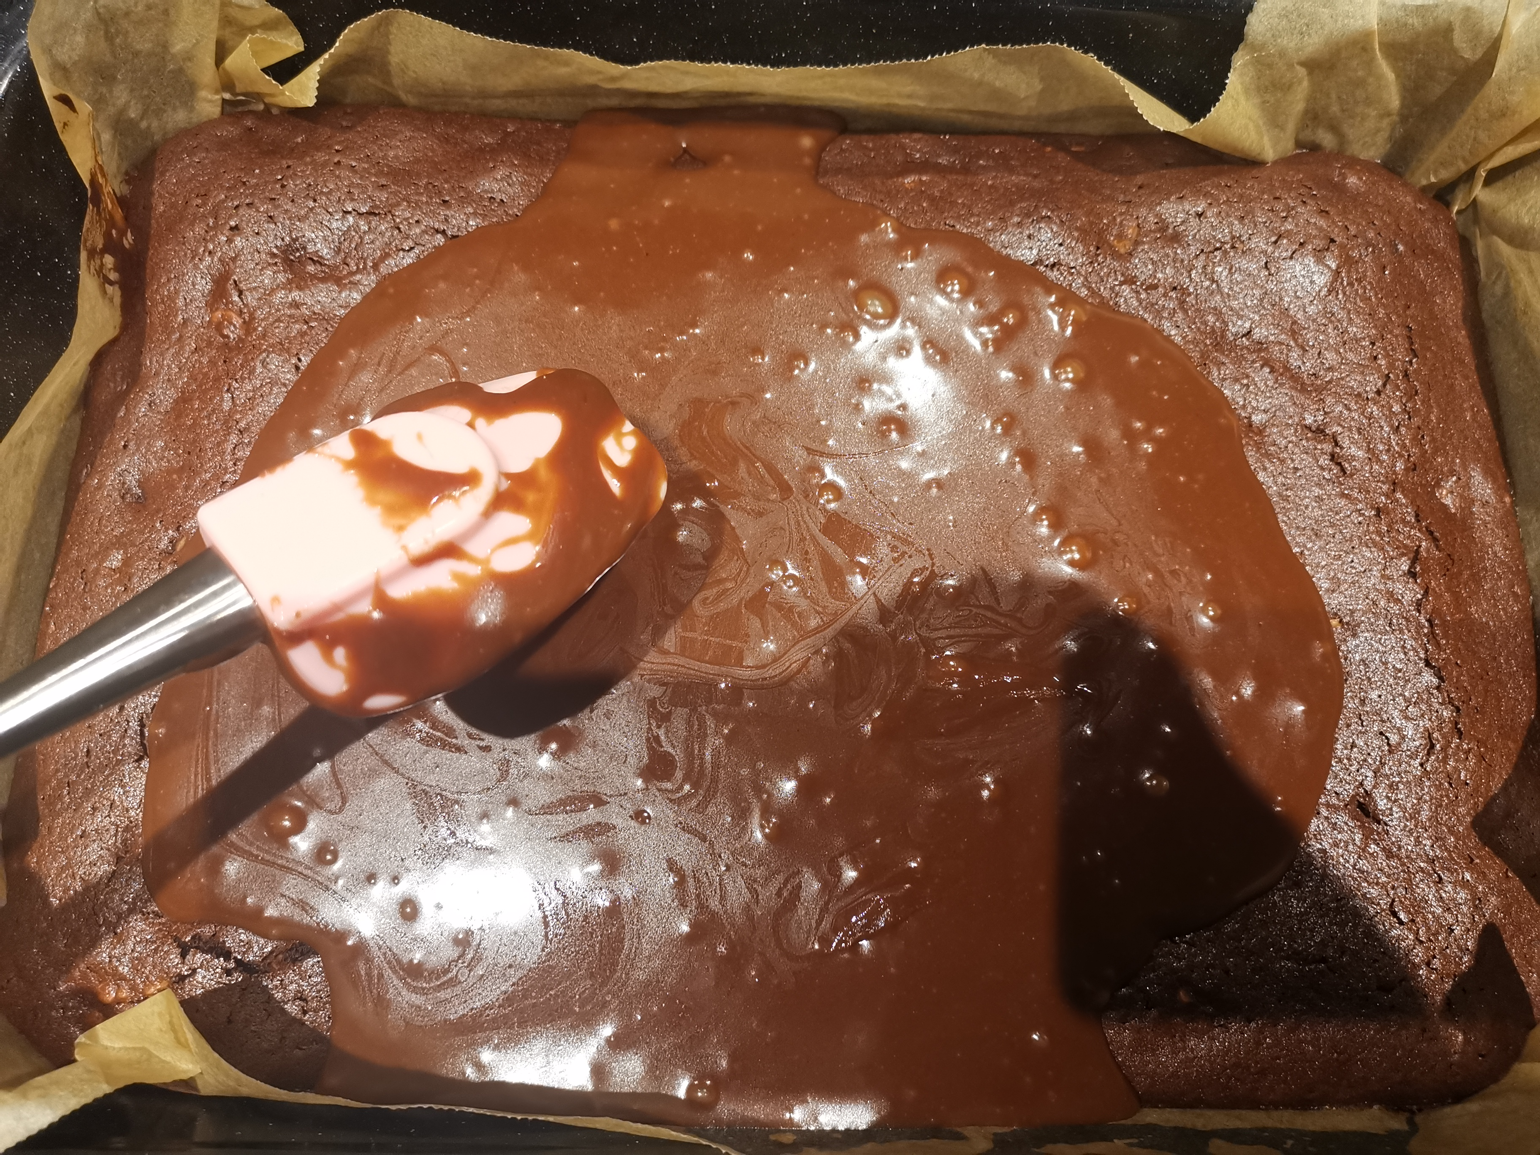
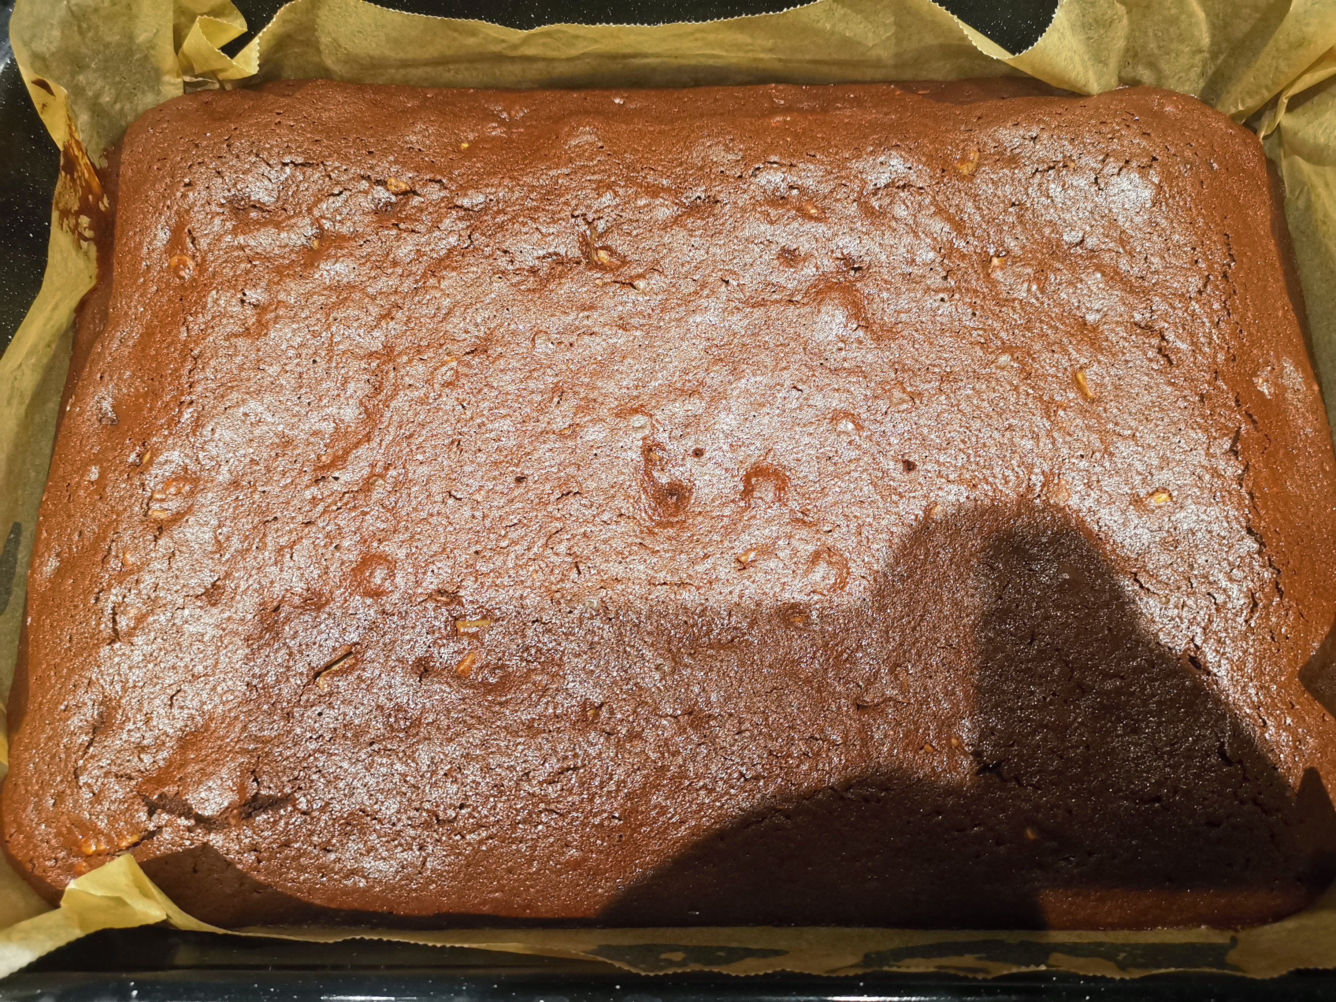
Once your cake is completely cooked and cooled down, pour the ganache and smooth out with a spatula. Leave to set before slicing into squares.

Slide 12
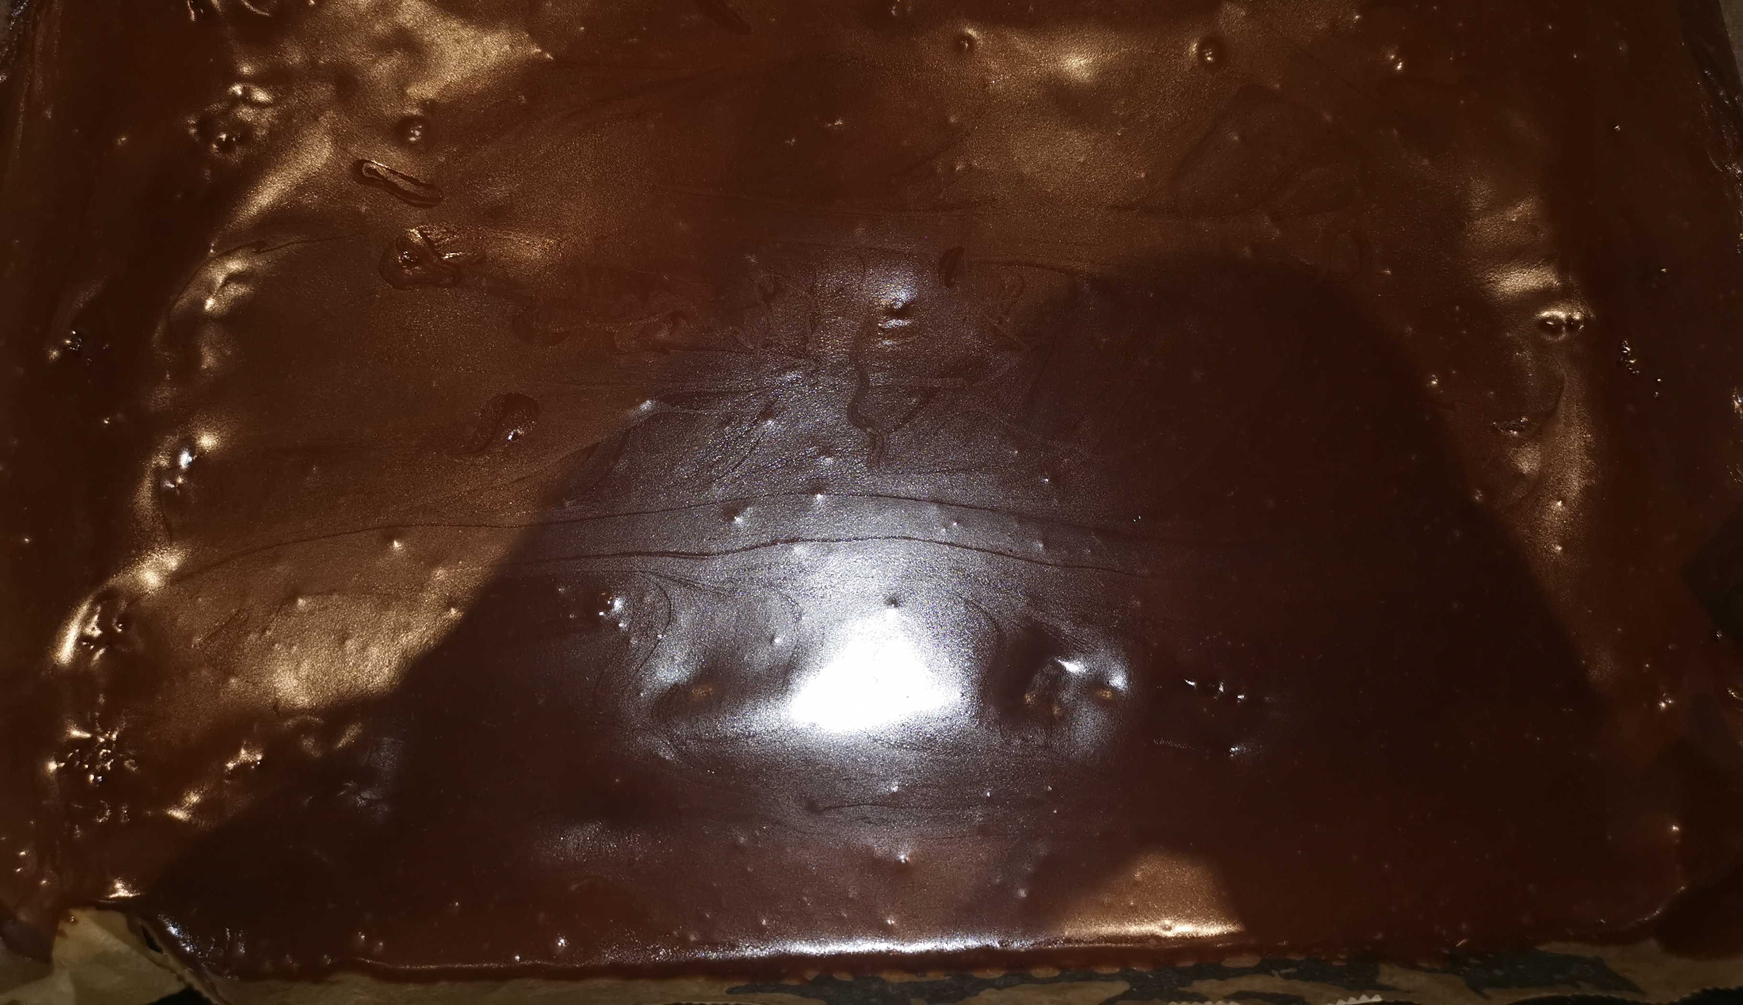
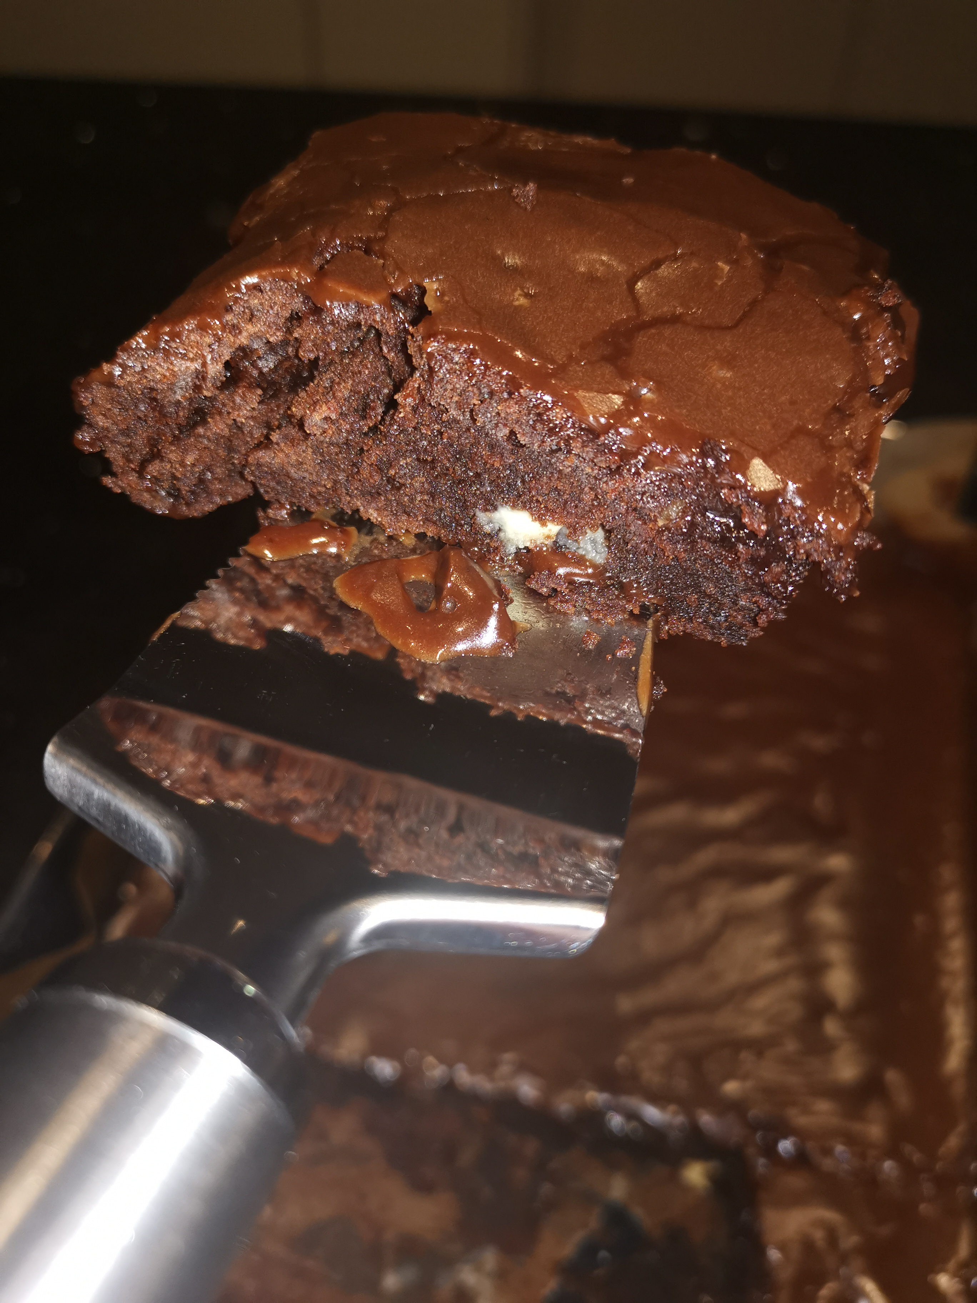
Enjoy with a glass of milk, tea or coffee (for adults)
☺

Slide 13
Have a lovely weekend!
See you back on Zoom on Monday ☺

