Slide 1
Christmas Songs

Slide 2
Twinkle, Twinkle Little Star
Twinkle, twinkle little star,
How I wonder what you are.
Up above the world so high,
Like a diamond in the sky.
Twinkle, twinkle little star,
How I wonder what you are.

Slide 3
Put Your Coat On
Put your coat on, put your coat on
And make yourself nice and cosy
Put your coat on, put your coat on
And come along out to play

Slide 4
Put your hat on, put your hat on
And make yourself nice and cosy
Put your hat on, put your hat on
And come along out to play

Slide 5
Put your gloves on, put your gloves on
And make yourself nice and cosy
Put your gloves on, put your gloves on
And come along out to play

Slide 6
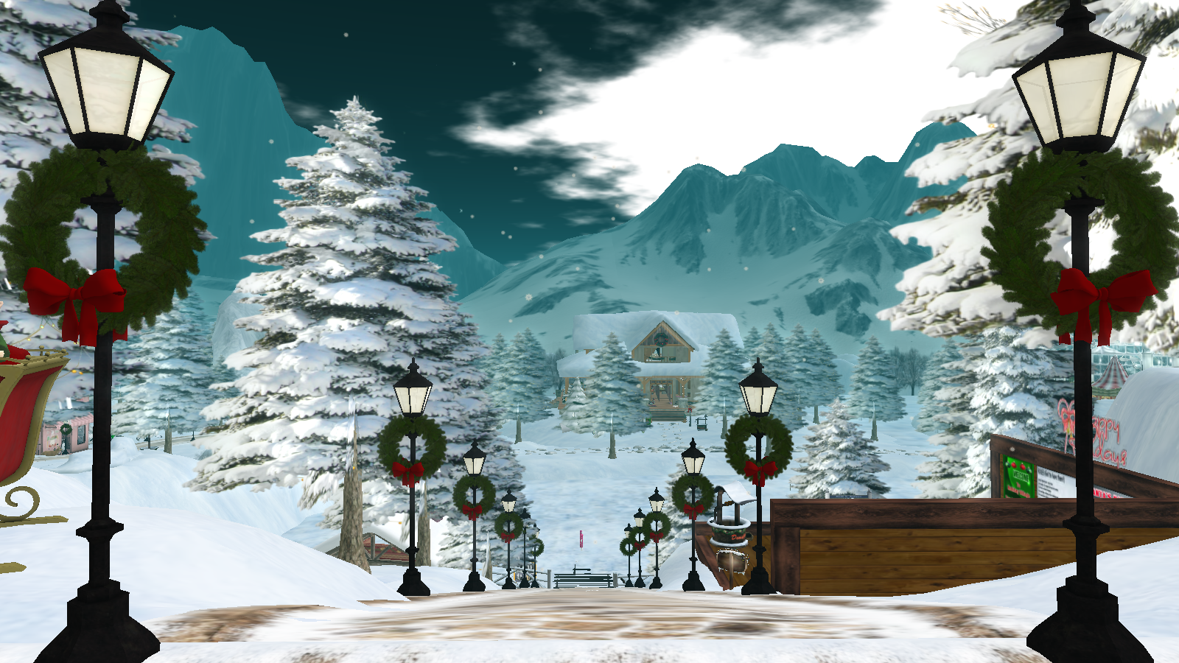
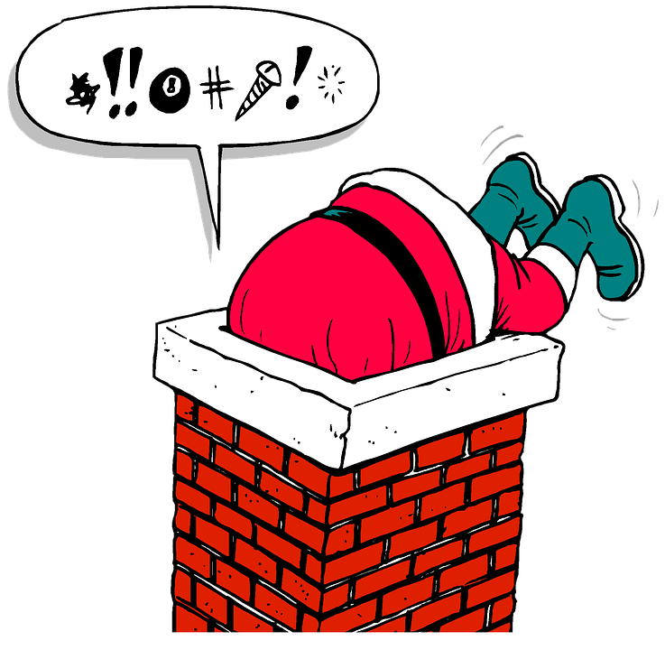
Father Christmas
Father Christmas
Christmas
He got stuck
He got stuck
Coming down the chimney
Coming down the chimney
What bad luck
What bad luck
Help!!!

Slide 7
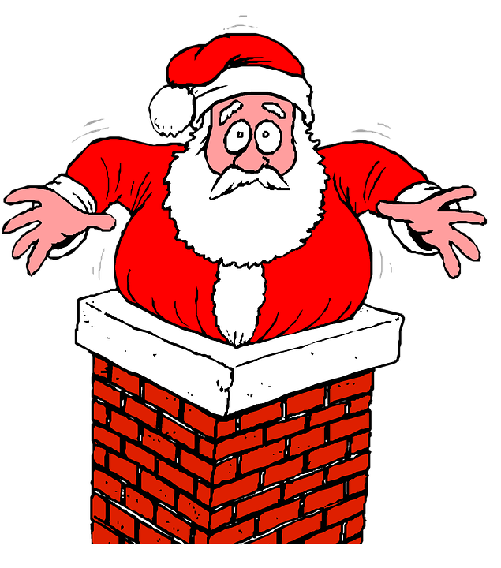
When Santa Got Stuck
When Santa got stuck up the chimney
He began to shout
You girls and boys
Won’t get any toys
If you don’t pull me out
My beard is black
There’s soot in my sack
My nose is tickling too
When Santa got stuck up the chimney
Atchoo! Atchoo! Atchoo!

